Slide 1
Objective 6.04 Landscape Design

Slide 2
1. What is a landscape?
The outdoor living space.

Slide 3
2. What are some of the goals that might need to be considered when planning a landscape?
Recreation and entertainment.

Slide 4
Privacy.

Slide 5
Comfort.

Slide 6
Beauty and creativity.

Slide 7
Safety.

Slide 8
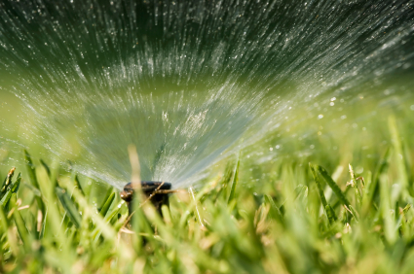
Ease of maintenance.

