Slide 1
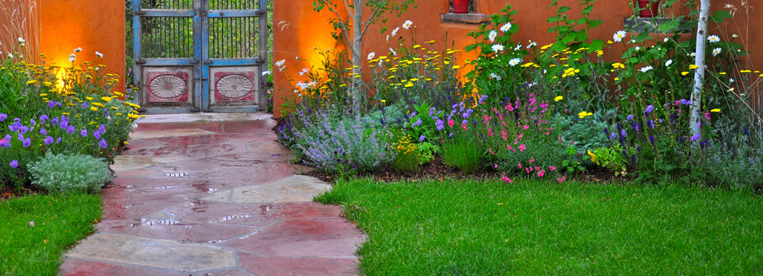
3. What are the two basic elements of a landscape?
Natural elements – soil, trees, shrubs, flowers, groundcovers, boulders, stones, wood, bark, water, sun, and wind
Manufactured elements – walks, driveways, steps, walls, fences, patios, and decks.

Slide 2
4. Briefly describe the importance of each natural element in a landscape.
Topography – the contour of the land. Level land is the easiest and least expensive to landscape
Soil – provides nutrients and must drain well, yet hold water to sustain the plant.

Slide 3
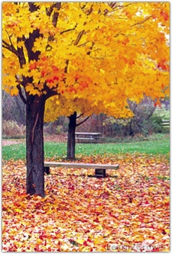
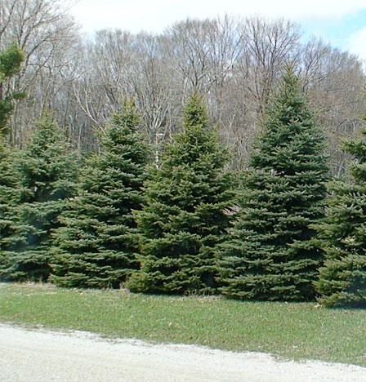
Trees and shrubs – provide shade and shelter from the wind.
deciduous
coniferous

Slide 4
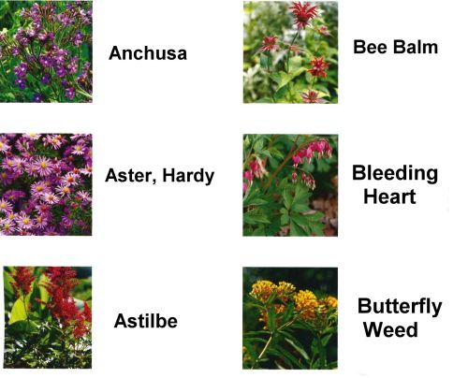
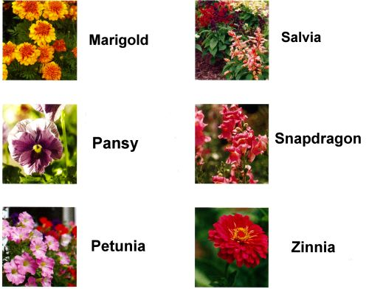
Flowers – add fragrance and color.
Perennials – bloom without replanting
Annuals – plant yearly

Slide 5
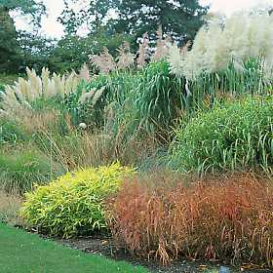
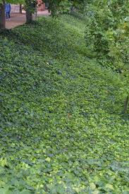
Ground cover – ornamental grasses and low-growing plants are used where lawns are not desired.
Ornamental grasses
English ivy

Slide 6
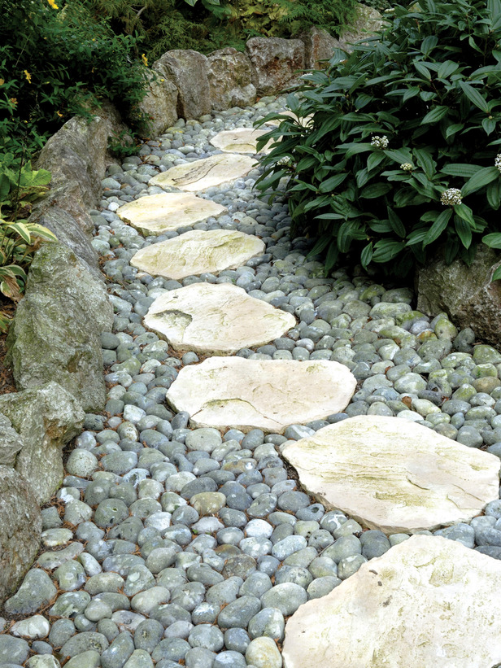
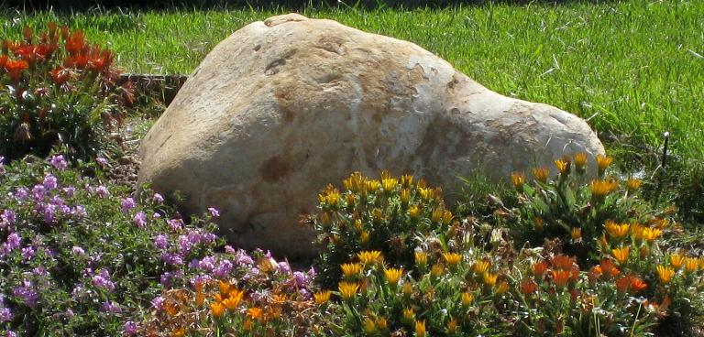
Boulders and stones (hardscape) – add interest, form and texture.

Slide 7
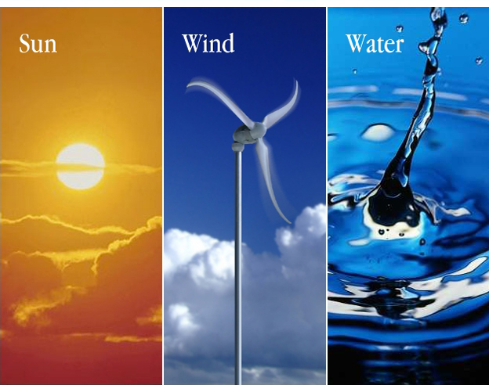
Water, sun, and wind are the basic needs of any landscape
Orientation to the sun and wind affect the use of outdoor space
Water needs to be controlled to prevent wet basements and swampy yards.

Slide 8
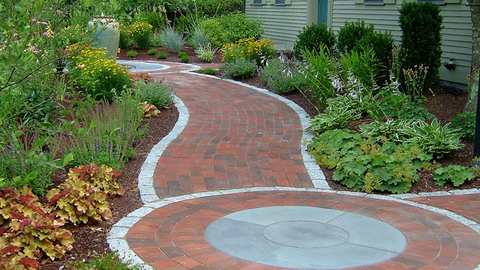
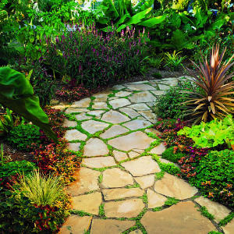
5. Briefly describe the importance of each manufactured element in a landscape.
Hard surfaces (walks/paths, driveways, steps, patios, decks)
Made of brick (masonry), concrete, or asphalt
Flagstone is very attractive and can be placed in concrete or on sand.

Slide 9
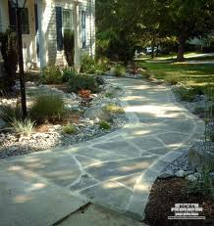
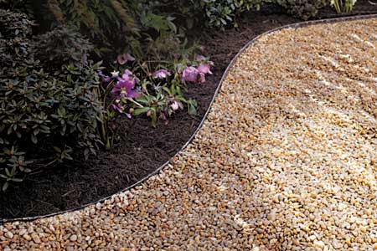
Walkway vs. Path
Both at least 3’ wide.

Slide 10
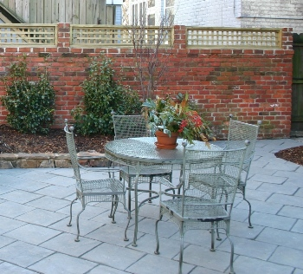
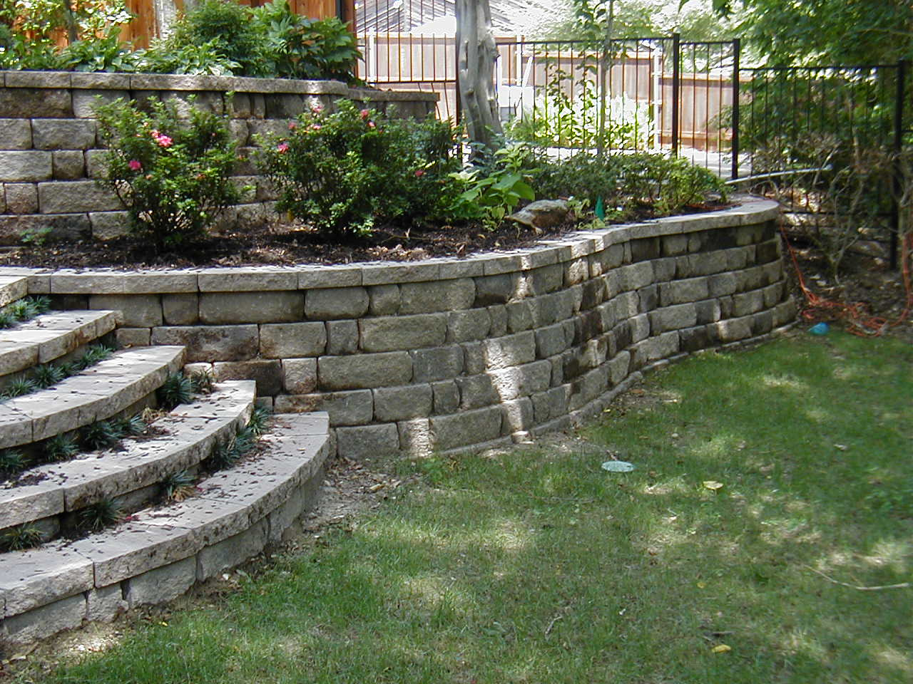
Enclosure elements - Used to keep children and pets in or unwanted visitors out
Freestanding wall: provide privacy and define boundaries
Fences: same as above but less expensive
Retaining walls: have soil against one side and can be used for terracing or to prevent erosion.

Slide 11
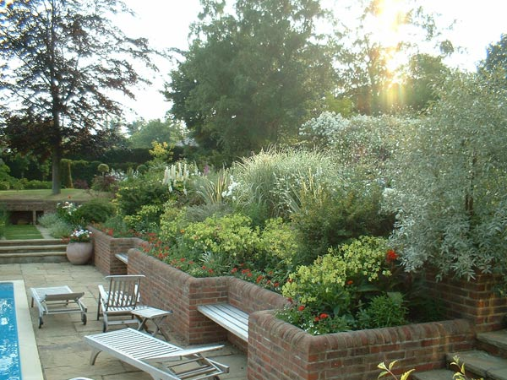
Outdoor furniture – constructed of many materials or might be built in with an enclosure.

Slide 12
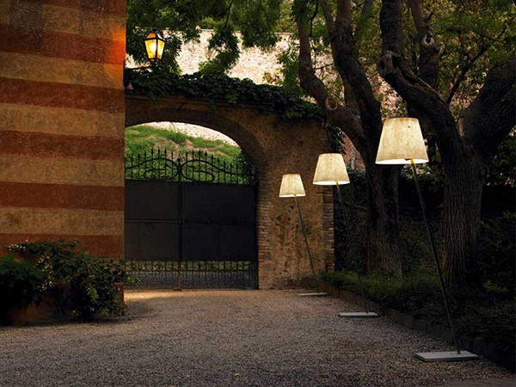
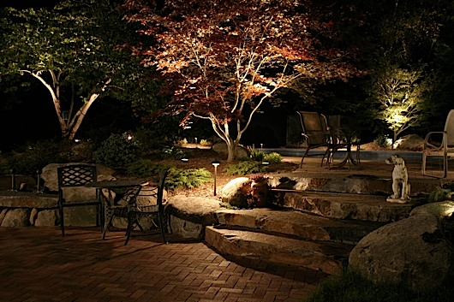
Artificial lighting – including timers and motion detectors.

Slide 13
6. Just like indoor spaces, outdoor spaces are divided into zones. List and describe the three landscape zones.
Public zone – can be seen from the street
Private zone – area for recreation and relaxation
Service zone – sidewalks, driveways, and storage areas.

Slide 14
7. What creates the floor of an outdoor room?
The topography and the soil
8. What are the floor coverings of an
outdoor room?
Hard surfaces and ground covers.

Slide 15
9. What creates the walls of an outdoor room?
Trees, shrubs, wall, and fences
10. What are the accessories or
accents in an outdoor room?
Flowers, boulders, stones, sculptures, murals, mosaics.

Slide 16
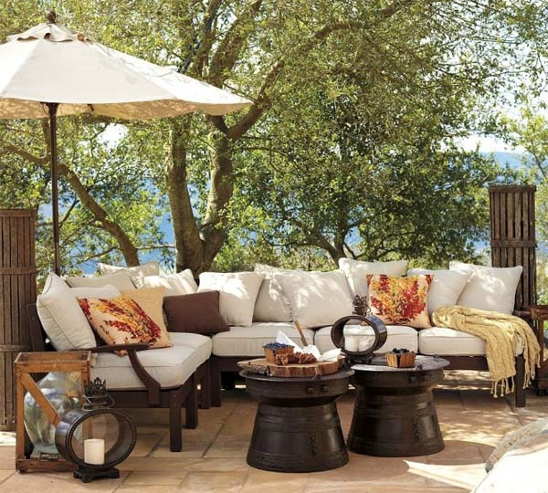
11. What should be considered when choosing outdoor furniture?
Durable
Weather resistant
High quality construction
Resist deterioration caused by extreme weather conditions
Resist soiling
Easy to move.

Slide 17
12. How can lighting be used in an outdoor space?
Extend the use of outdoor space
Enhance the view
Illuminate sidewalks and driveways
Discourage intruders.

Slide 18
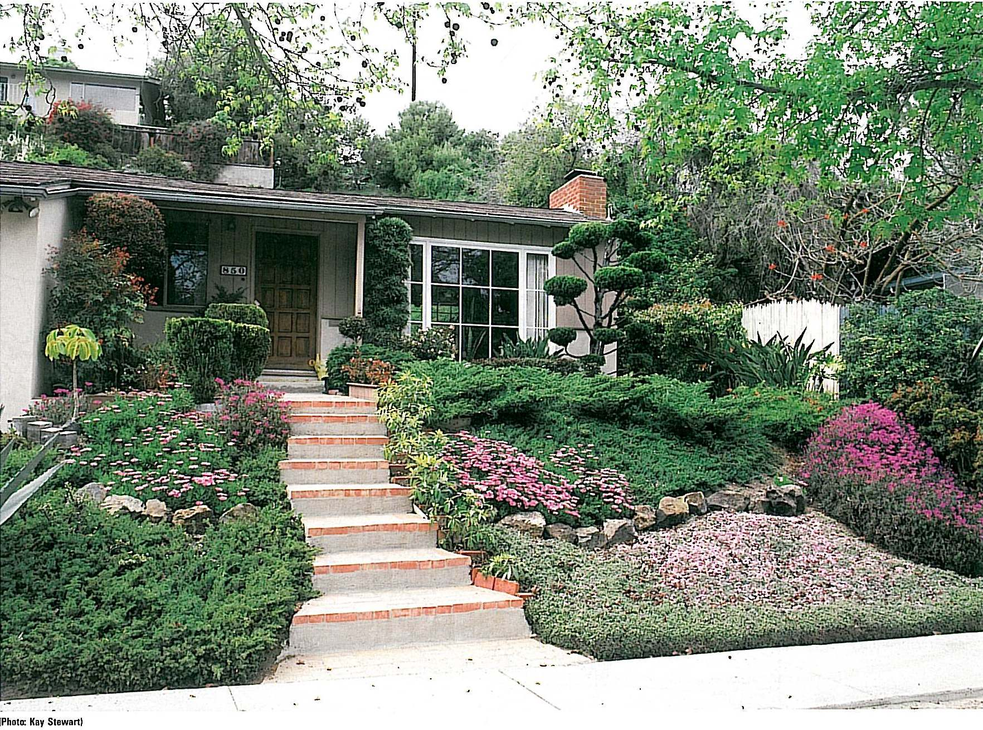
13. What is xeriscaping and how is it accomplished?
Landscapes that are designed to tolerate drought and conserve water
Are low-maintenance
Choose plants that are native to the location.

Slide 19
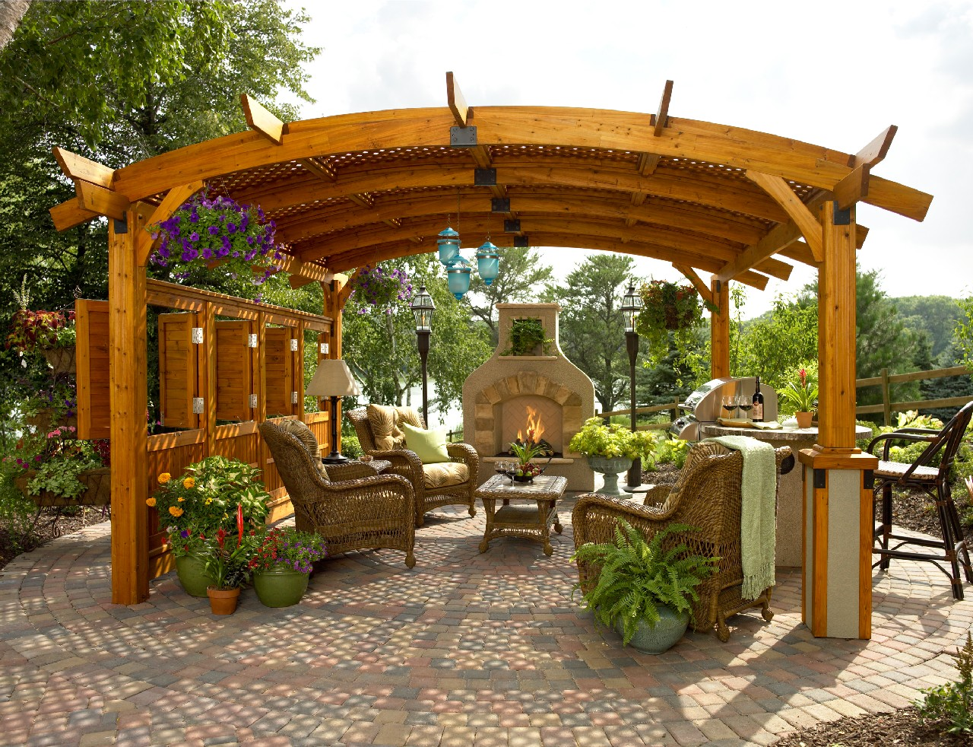
Other Terms
Pergola

Slide 20
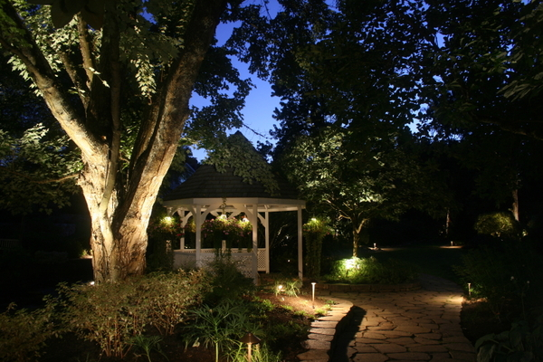
Gazebo

