Slide 1
Answer these questions.
List five reasons why we have housing standards.
What are zoning laws?
What is the purpose of building codes? What do they cover?
What is the Uniform Building Code?
What are aesthetic codes?
What is the purpose of a building permit?
What is a building code variance?
What is the American with Disabilities Act (ADA)?

Slide 2
Objective 6.03: Cite sources and uses of building code requirements.

Slide 3
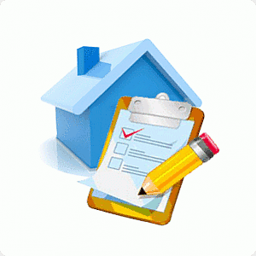
1. List five reasons why we have housing standards.
To control use of land
To control dwelling construction
To control density
To separate residences from industry
To protect human health

Slide 4
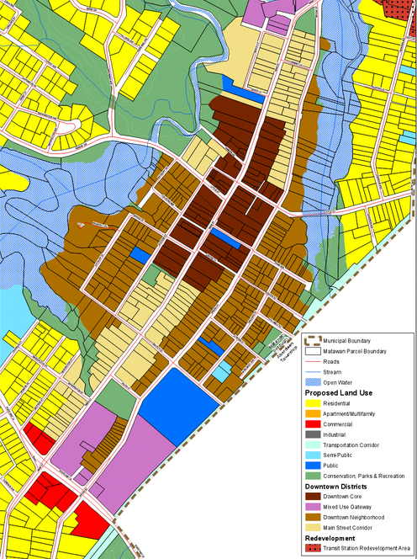
2. What are zoning laws?
Zoning laws regulate how a section of land can be used and what type of structure can be built on the land

Slide 5
3. What is the purpose of building codes? What do they cover?
Building codes:
Regulate the details of the structures
Establish minimum standards for materials and construction methods
Regulate construction related areas including plumbing, heating, electrical, and safety and sanitary conditions.

Slide 6
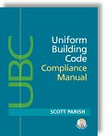
4. What is the Uniform Building Code?
The most widely adopted building code in the world
Sets minimum standards for building construction.

Slide 7
5. What are aesthetic codes?
Regulations used to focus on the beauty of the community
Can include style of architecture, paint and roofing colors, and types of landscaping plants.

Slide 8
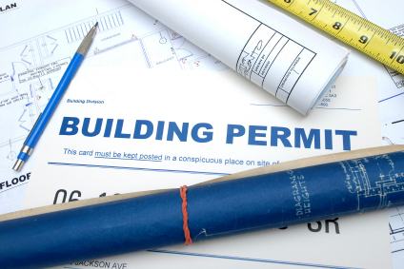
6. What is the purpose of a building permit?
Permits give permission to individuals to build or renovate
Permits certify that all code specifications (rules) have been considered (followed)

Slide 9
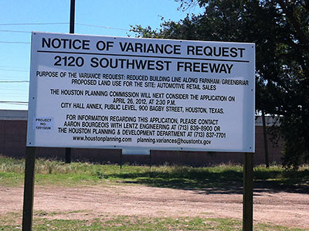
7. What is a building code variance?
A license to waive (allow an exception to) a zoning or building code.

Slide 10
8. What is the American with Disabilities Act (ADA)?
Law that requires equal access for all people in the design or redesign of public structures.

