Slide 1
Objective 6.01 Mid 20th Century to Present
Postwar modern
Ranch
Contemporary
Split-level
Shed
Traditional
Innovative
A-Frame
Geodesic dome

Slide 2
Post-War Modern: Ranch
Asymmetrical
Spreading, horizontal orientation
Floor plan in a rectangular, L-, or U-shape
Minimal ornamentation
Attached garages.

Slide 3
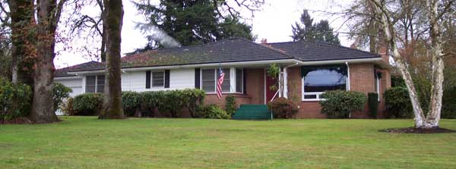
Post-War Modern: Ranch

Slide 4
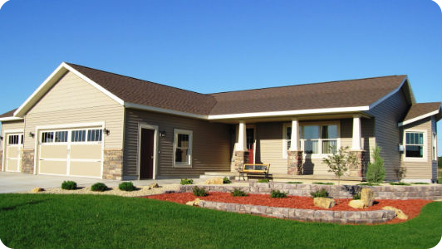
Post-War Modern: Ranch

Slide 5
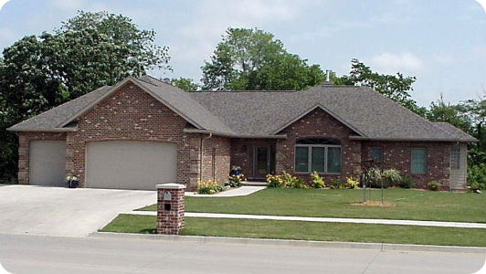
Post-War Modern: Ranch

Slide 6
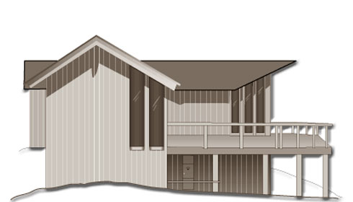
Post-War Modern: Contemporary
No particular shape or style
Wide eaves
Flat or low-pitched roofs
Exposed supporting beams
Unusual placement and shapes of windows.

Slide 7
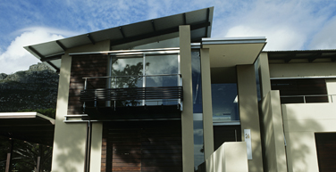
Post-War Modern: Contemporary

Slide 8
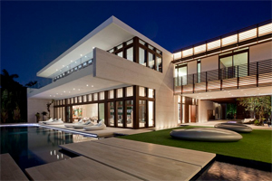
Post-War Modern: Contemporary

Slide 9
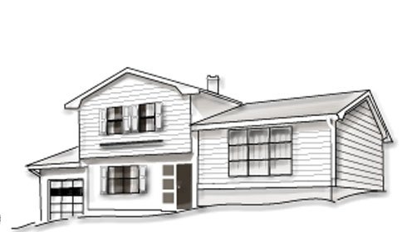
Post-War Modern: Split Level
Has three or four levels
Designed to take advantage of a sloping lot
Provides the space of a ranch home without requiring as much land.

Slide 10
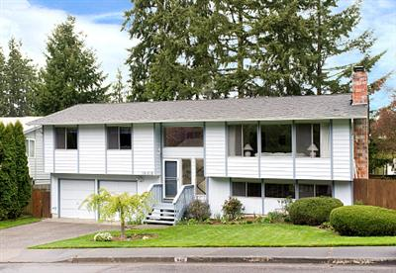
Post-War Modern: Split Level

Slide 11
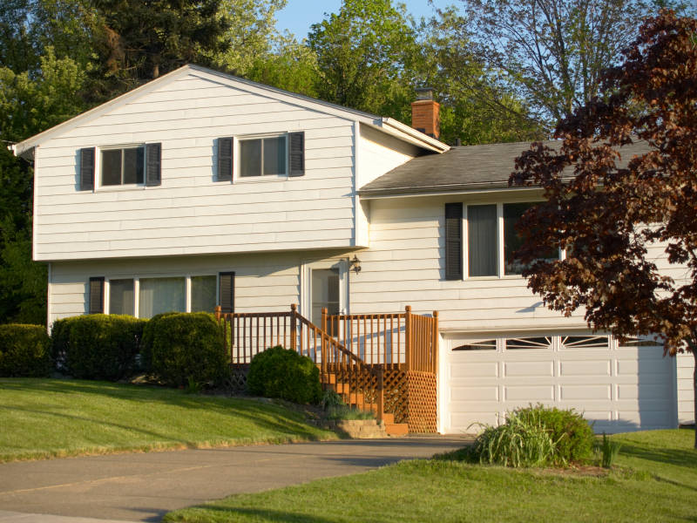
Post-War Modern: Split Level

Slide 12
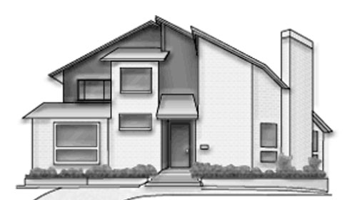
Mid 20th Century to Present: Shed Homes
Roof line is made up of a combination of steeply pitched shed roofs
Usually wood shingle or board sliding applied horizontally, vertically, or diagonally
Windows are normally small and placed asymmetrically.

Slide 13
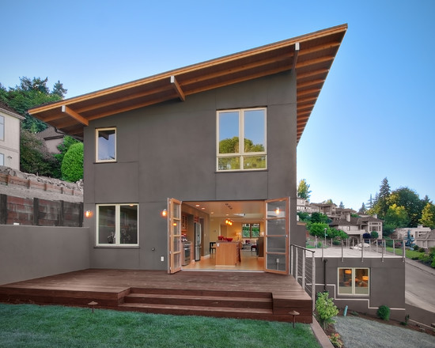
Post-War Modern: Shed Homes

Slide 14
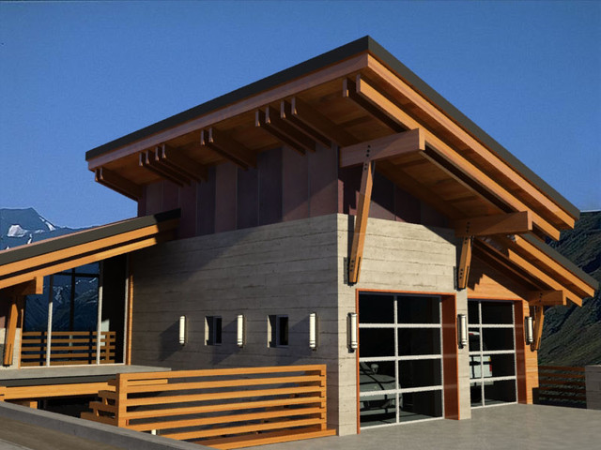
Post-War Modern: Shed Homes

Slide 15
Mid 20th Century: Traditional
After the WWII anyone was able to buy a house
Basic and small
1 or 2 stories
Has a long drive way

Slide 16
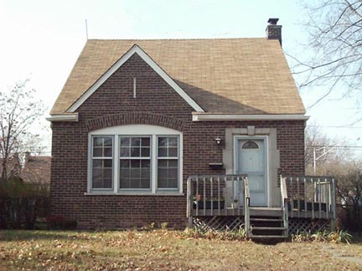
Mid 20th Century: Traditional

Slide 17
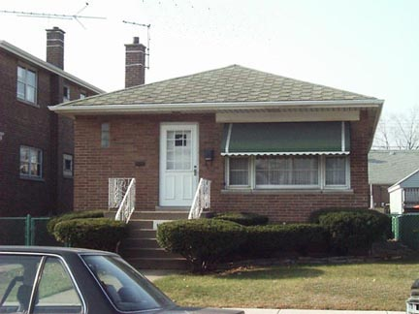
Mid 20th Century: Traditional

Slide 18
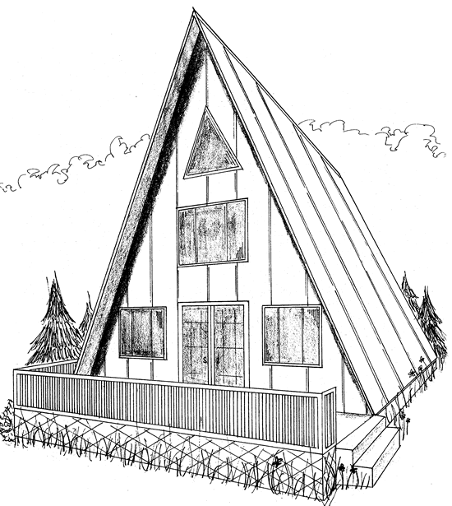
Mid 20th Century Innovative: A-Frame Homes
Gable roof that extends to ground level on two sides
Eliminates the need for separate walls
Odd interior space created by its design.

Slide 19
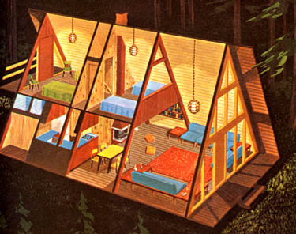
Mid 20th Century Innovative: A-Frame Homes

Slide 20
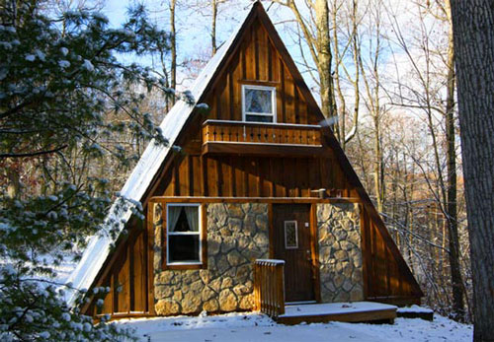
Mid 20th Century Innovative: A-Frame Homes

Slide 21
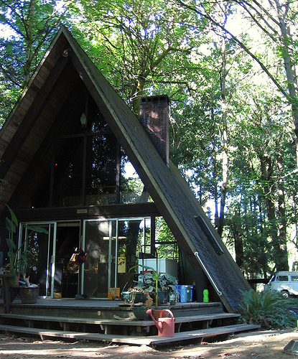
Mid 20th Century Innovative: A-Frame Homes

Slide 22
Mid 20th Century Innovative: Geodesic Dome
Triangular frames joined to form a self-supporting roof and walls
Metal or plastic covered by a flexible skin or rigid panels
Low cost, energy-saving

Slide 23
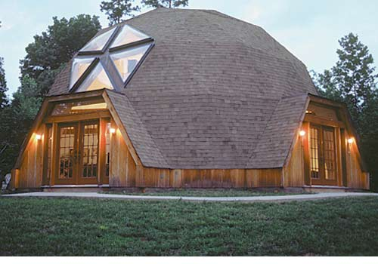
Mid 20th Century Innovative: Geodesic Dome

Slide 24
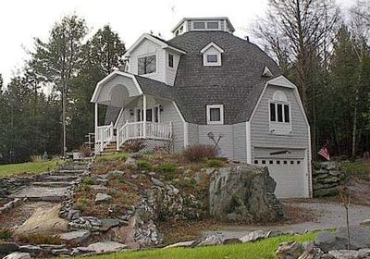
Mid 20th Century Innovative: Geodesic Dome

