Slide 1
Objective 6.01
Early Twentieth Century Housing
Revival styles
    Colonial Revival style
    Tudor style
    Chateauesque
    Mission
Modern Styles
    Prairie
    Craftsman/Bungalow
    International

Slide 2
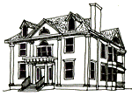
    Early 20th Century Revival: Colonial
    Similar to Georgian, Federal, Adam, Greek Revival
Machine-made woodwork that had less depth and relief than earlier handmade versions.

Slide 3
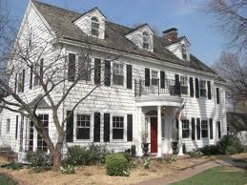
  Early 20th Century Revival: Colonial

Slide 4
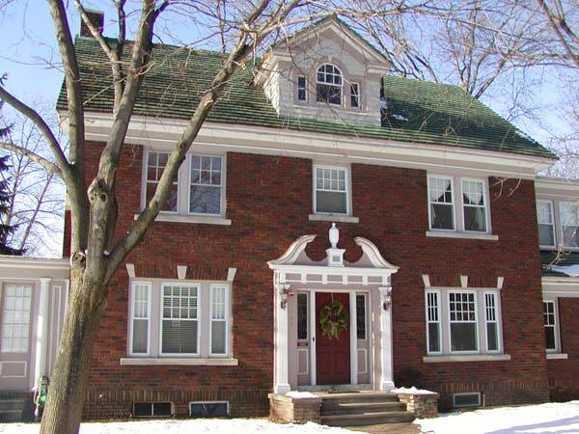
  Early 20th Century Revival: Colonial

Slide 5
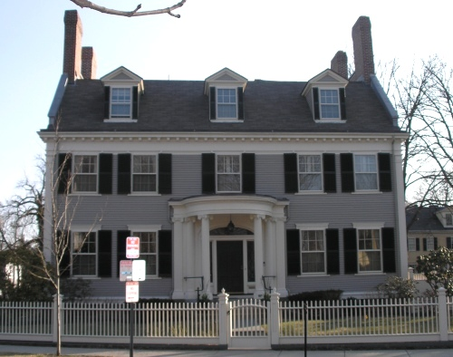
    Early 20th Century Revival: Colonial

Slide 6
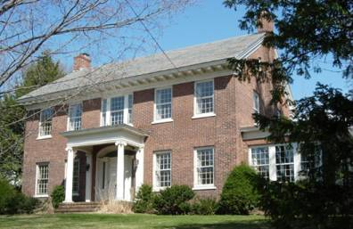
Early 20th Century Revival: Colonial

Slide 7
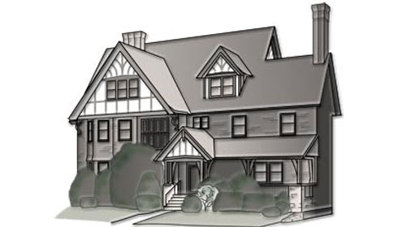
    Early 20th Century Revival: Tudor
Similar to Half-Timber

Slide 8
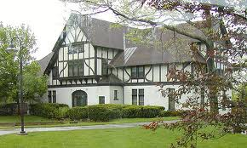
  Early 20th Century Revival: Tudor

Slide 9
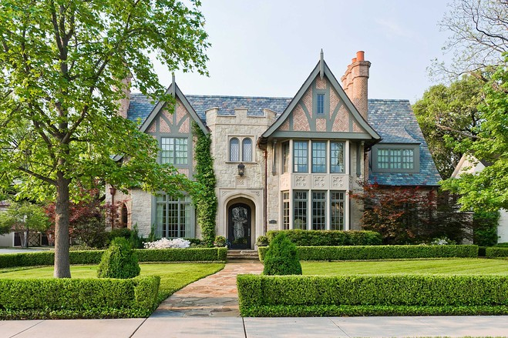
    Early 20th Century Revival: Tudor

Slide 10
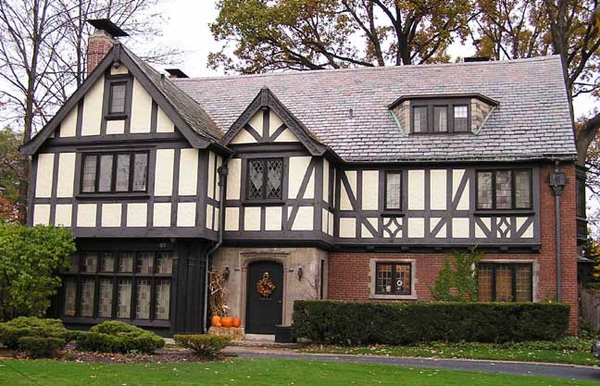
Early 20th Century Revival: Tudor

Slide 11
Early 20th Century Revival: Chateauesque
  Popular at turn of the century among wealthy
  Elaborate towers, spires, and steeply-pitched roofs
  Steeply pitched hipped or gable roof, often with cresting
  Tall chimneys with decorative caps
  Multiple dormers
  Usually of masonry (stone or brick) construction.

Slide 12
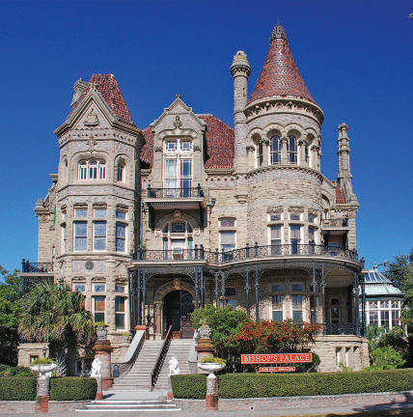
Early 20th Century Revival: Chateauesque

Slide 13
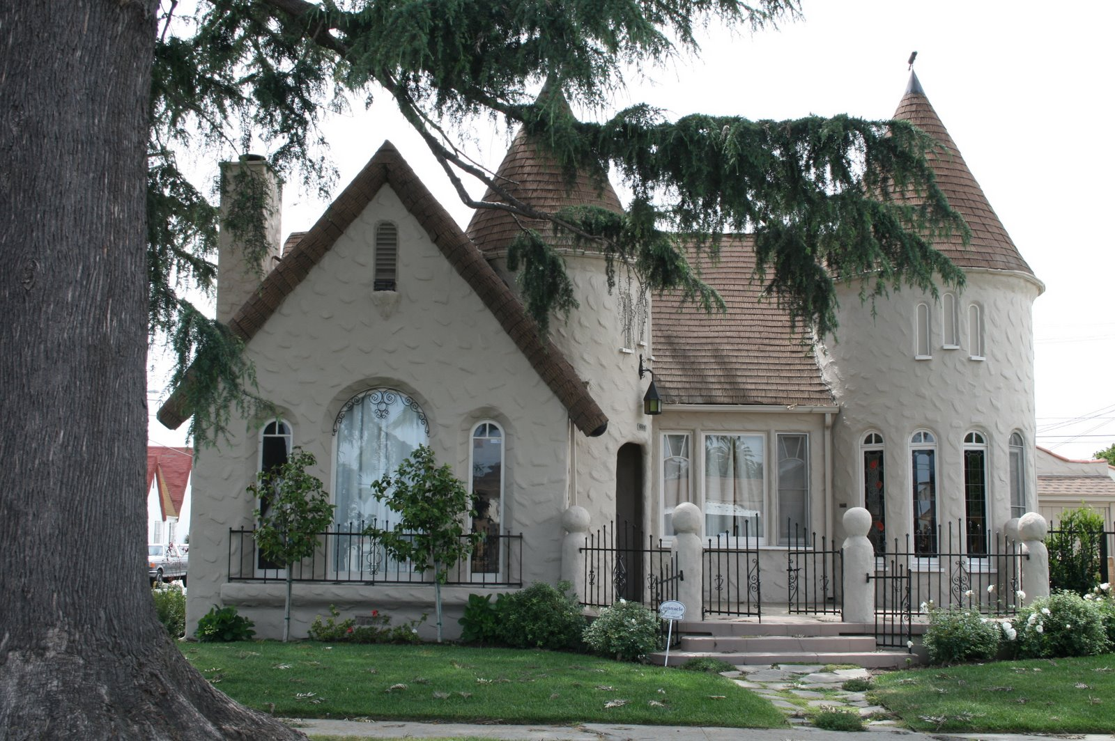
Early 20th Century Revival: Chateauesque

Slide 14
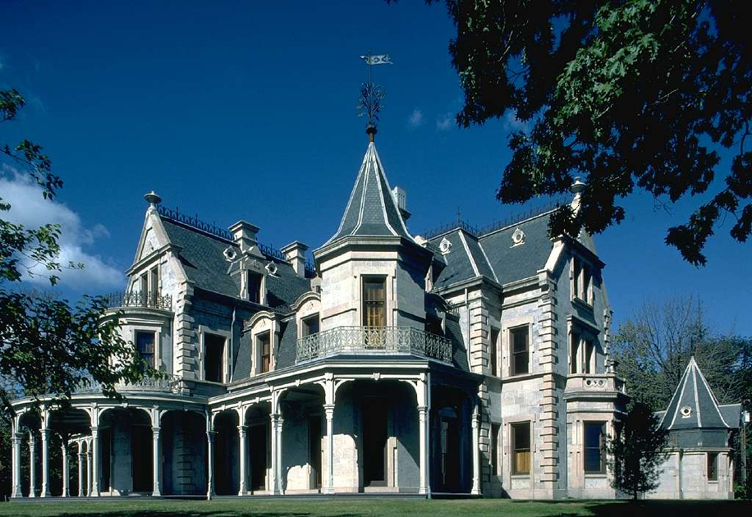
Early 20th Century Revival: Chateauesque

Slide 15
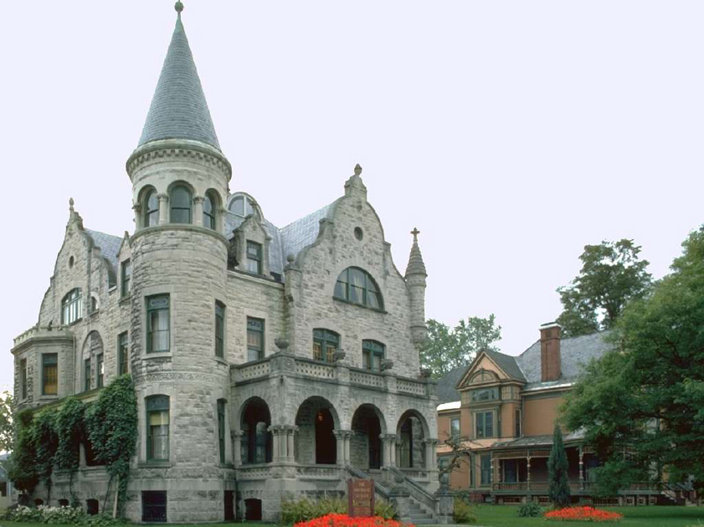
Early 20th Century Revival: Chateauesque

Slide 16
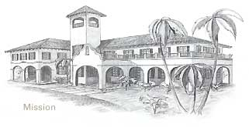
    Early 20th Century Revival: Mission
    Similar to Spanish architectural style

Slide 17
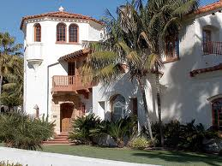
Early 20th Century Revival: Mission

Slide 18
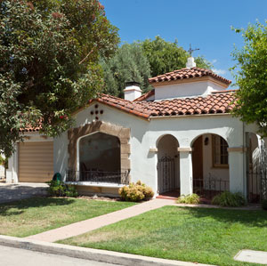
Early 20th Century Revival: Mission

Slide 19
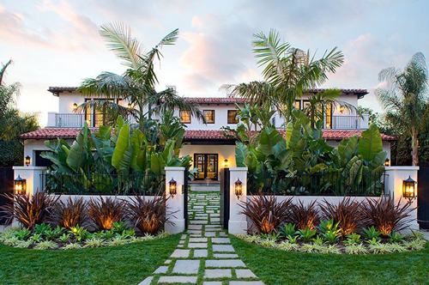
Early 20th Century Revival: Mission

Slide 20
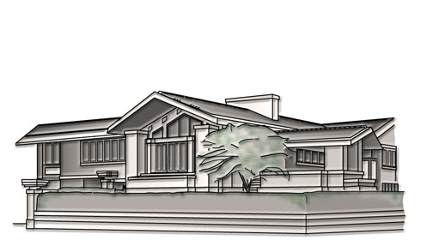
    Early 20th Century Housing: Prairie Style
Originated by Frank Lloyd Wright
Integrated with landscape and environment
1 - 2 story
Strong horizontal lines
Prominent, central chimney
Low-pitched hipped or flat roof
Broad, overhanging eaves
Projecting or cantilevered wings
Ribbons of windows arranged in horizontal bands
Clerestory windows
Rows of windows with geometric patterns
Windows placed together for the appearance of a glass wall
Wide use of natural materials especially stone and wood.

Slide 21

Early 20th Century Housing: Prairie Style Video

Slide 22
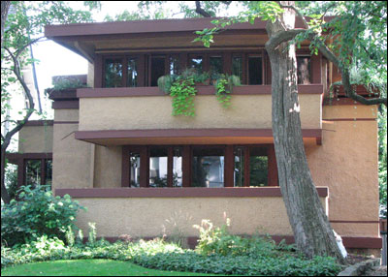
Early 20th Century Housing: Prairie Style

Slide 23
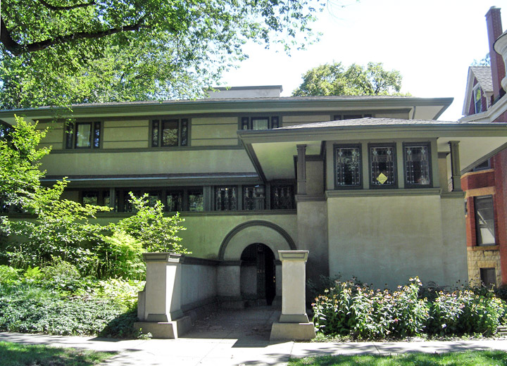
    Early 20th Century Housing: Prairie Style

Slide 24
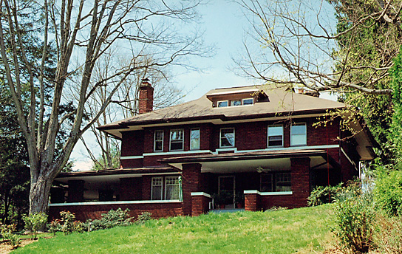
Early 20th Century Housing: Prairie Style

Slide 25
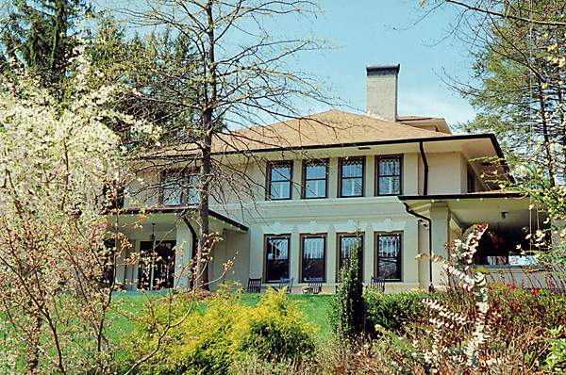
Early 20th Century Housing: Prairie Style

Slide 26
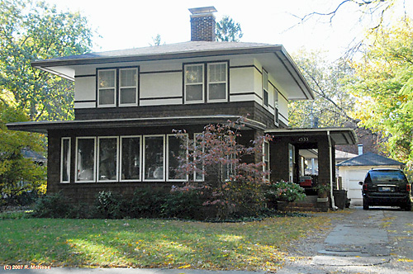
Early 20th Century Housing: Prairie Style

Slide 27
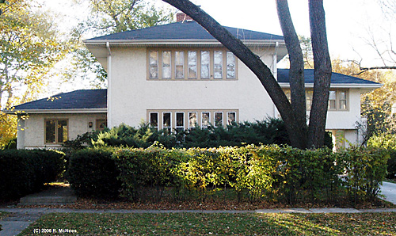
Early 20th Century Housing: Prairie Style

Slide 28
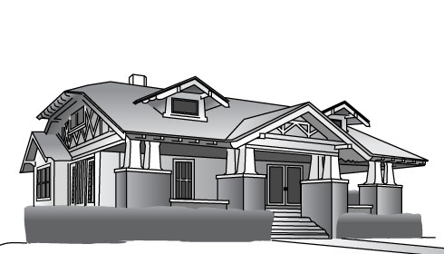
    Early 20th Century Housing: Craftsman/Bungalow
Originated in California then moved eastward
Rectangular one and one-half story
Low-pitched gabled or hipped roofs
Exposed rafters under wide eaves
Deep front porch with tapered columns
Doors have glass panes in the upper third of the door
Multi-pane windows with no mullions on the bottom sash
Single, wide dormers
So popular could order a bungalow kit from Sears and Roebuck catalog.

Slide 29
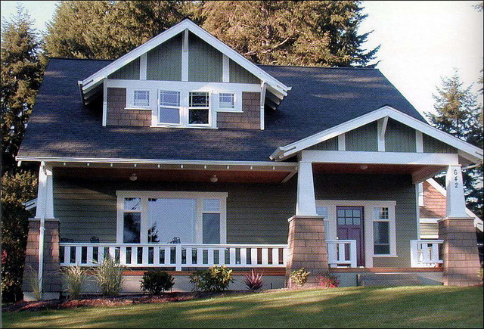
    Early 20th Century Housing: Craftsman/Bungalow

Slide 30
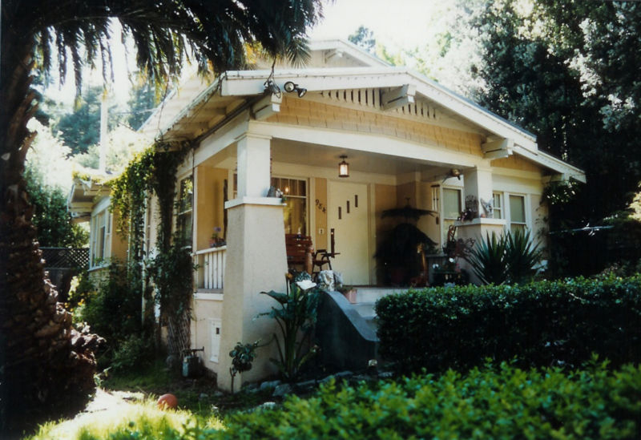
Early 20th Century Housing: Craftsman/Bungalow

Slide 31
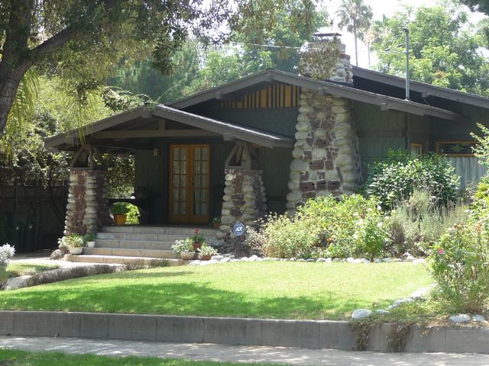
Early 20th Century Housing: Craftsman/Bungalow

Slide 32
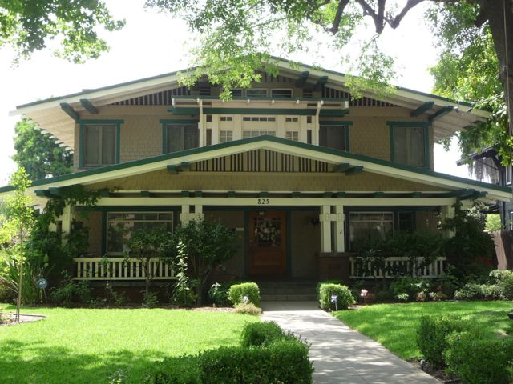
Early 20th Century Housing: Craftsman/Bungalow

Slide 33
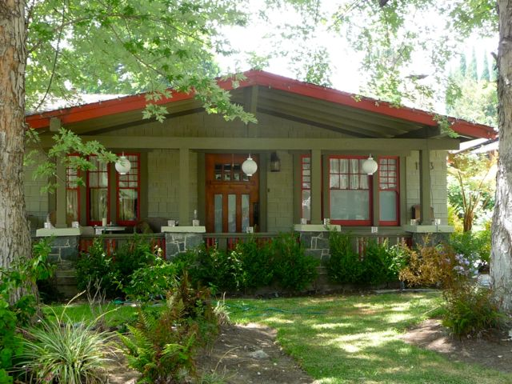
Early 20th Century Housing: Craftsman/Bungalow

Slide 34
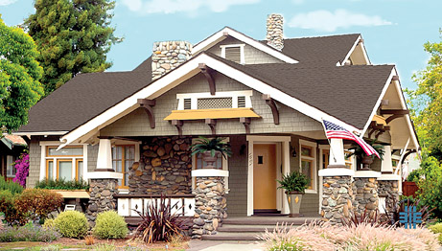
Early 20th Century Housing: Craftsman/Bungalow

Slide 35
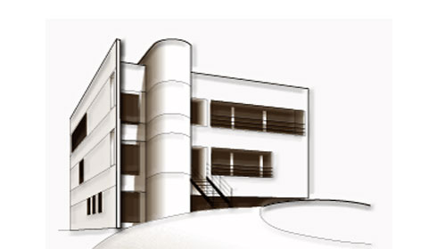
    Early 20th Century Housing: International Style
Asymmetrical facade
Rectangular forms
Flat roof
Lack of ornamentation or decorative details
Ribbon windows
Curtain walls of glass
Cantilevered projections
Smooth wall surfaces.

Slide 36
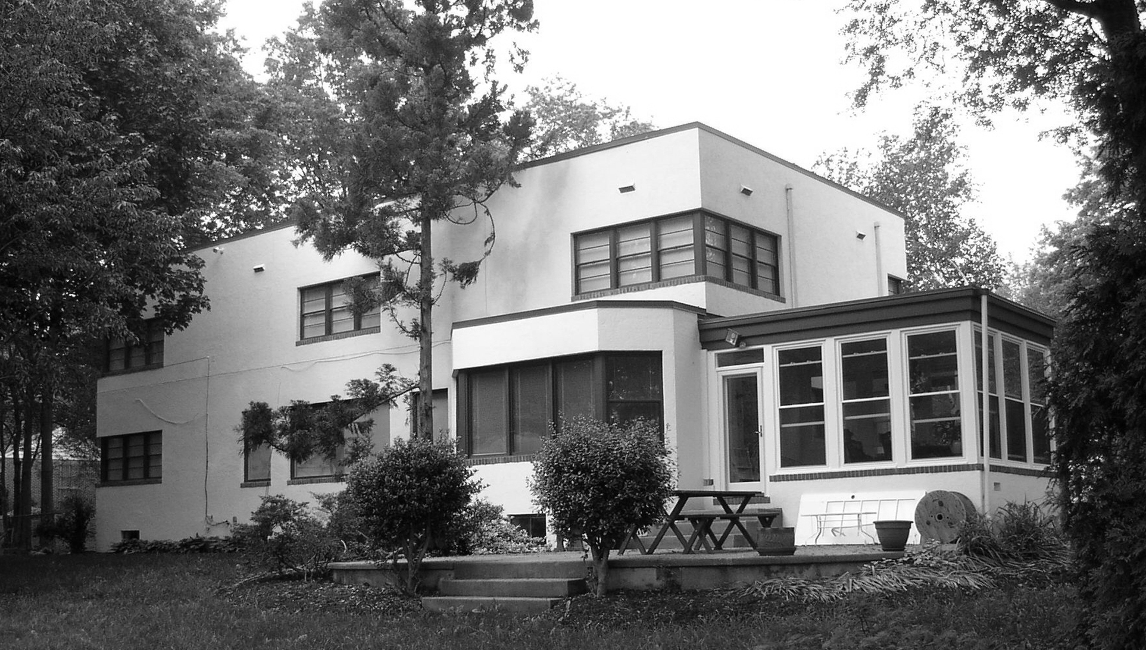
    Early 20th Century Housing: International Style

Slide 37
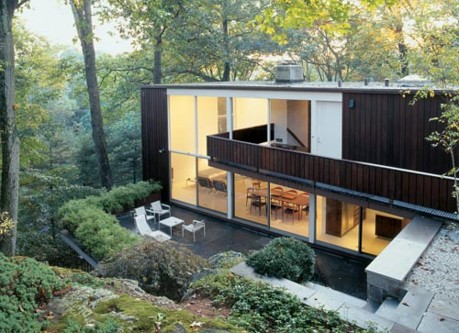
    Early 20th Century Housing: International Style

Slide 38
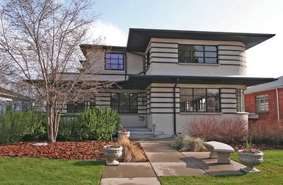
    Early 20th Century Housing: International Style

Slide 39
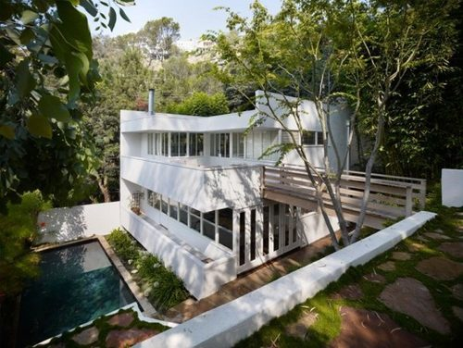
    Early 20th Century Housing: International Style

Slide 40
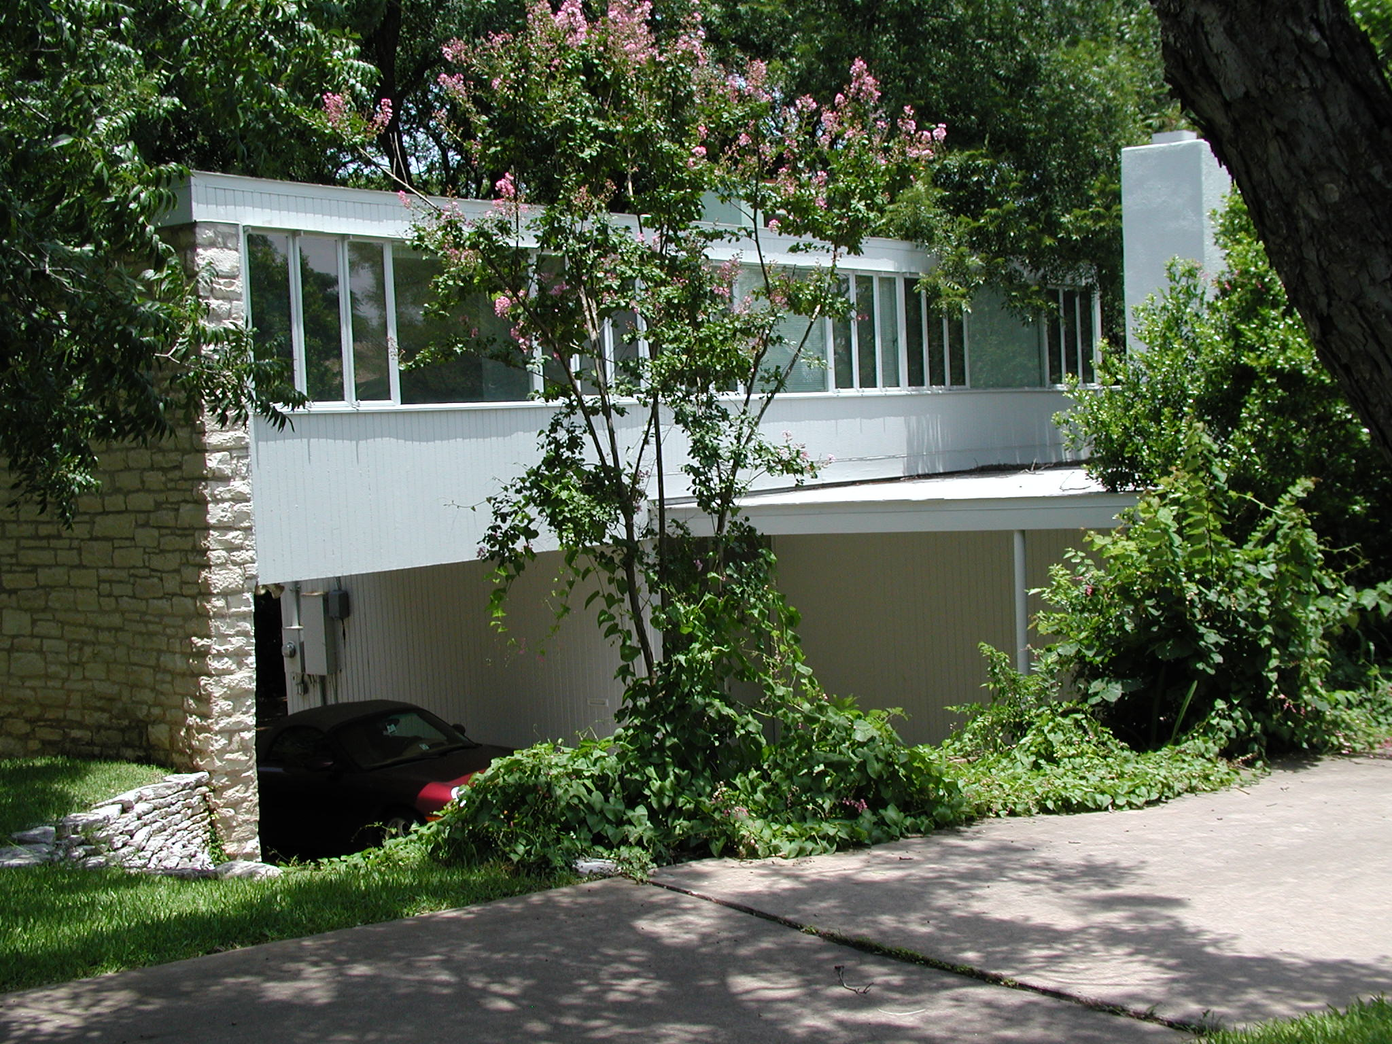
    Early 20th Century Housing: International Style

Slide 41
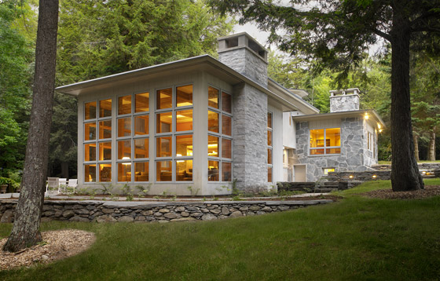
    Early 20th Century Housing: International Style

