Slide 1
Objective 6.01 Nineteenth Century Housing
Romantic Revival Period
Gothic
Italianate
Victorian Period
Second Empire
Queen Anne

Slide 2
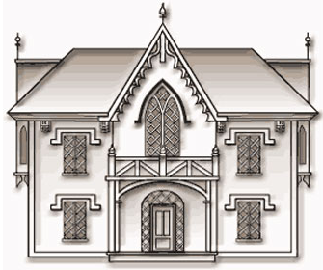
19th Century Romantic Revival: Gothic
Irregular shape
Steeply pitched, cross-gabled roof
High dormers
Elaborate gingerbread trim
Pointed-arch windows, sometimes stained glass, like churches
Gothic window above entry
One-story porch with flattened, Gothic arches.

Slide 3
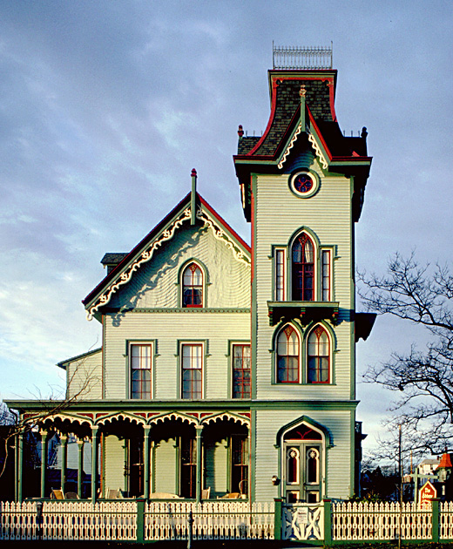
19th Century Romantic Revival: Gothic

Slide 4
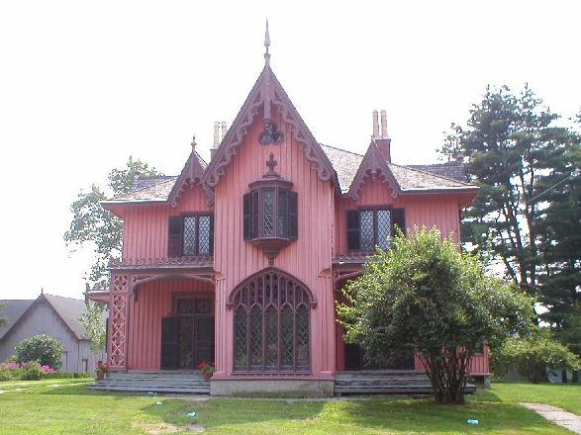
19th Century Romantic Revival: Gothic

Slide 5
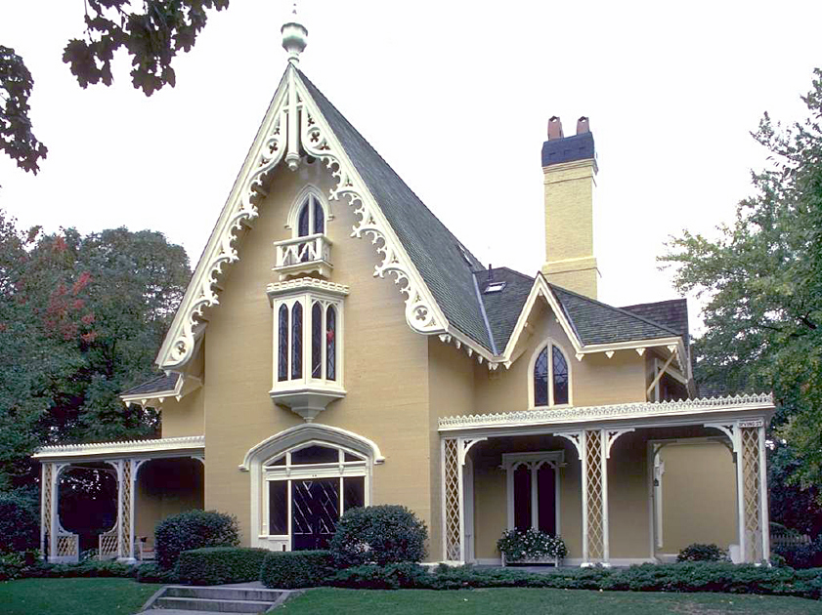
19th Century Romantic Revival: Gothic

Slide 6
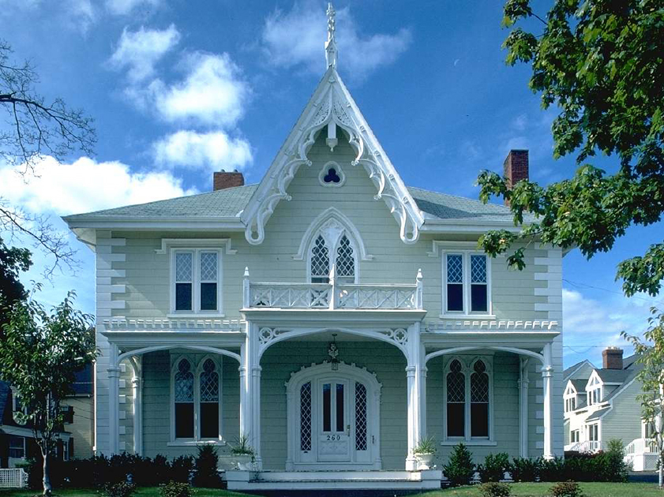
19th Century Romantic Revival: Gothic

Slide 7
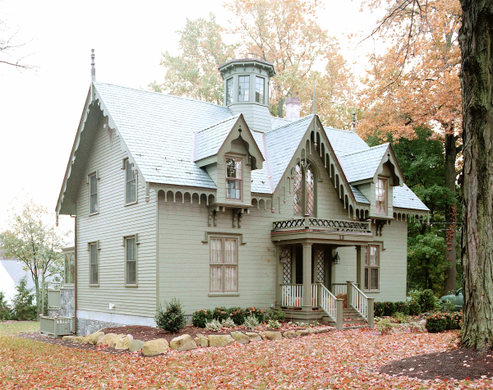
19th Century Romantic Revival: Gothic

Slide 8
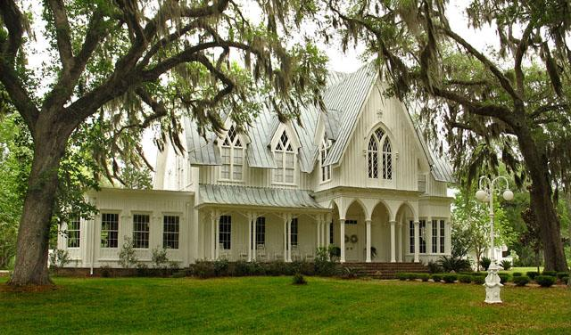
19th Century Romantic Revival: Gothic

Slide 9
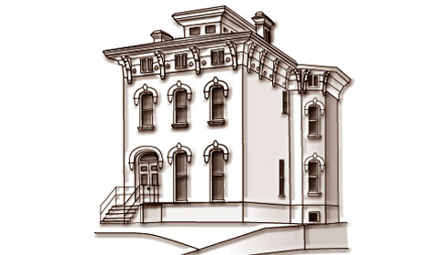
19th Century Romantic Revival: Italianate
Two or three stories; typically asymmetrical
Low-pitched, hipped roof with wide overhanging eaves
Large eave brackets on cornice
Tall, narrow windows; paired and triple; bay windows common
Windows embellished with heavy crown molding or pediments in inverted U-shape
Porches
Paired arched doorways with large-pane glazing in door and elaborate framing
Square cupolas or towers
Horizontal belt courses and corner quoins
Balconies with balustrades.

Slide 10
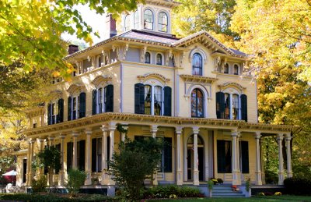
19th Century Romantic Revival: Italianate

Slide 11
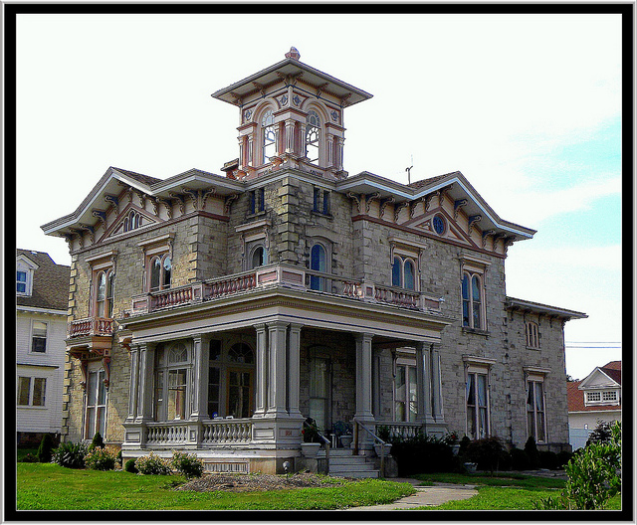
19th Century Romantic Revival: Italianate

Slide 12
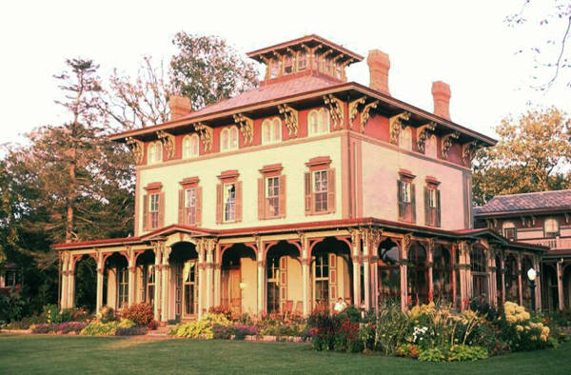
19th Century Romantic Revival: Italianate

Slide 13
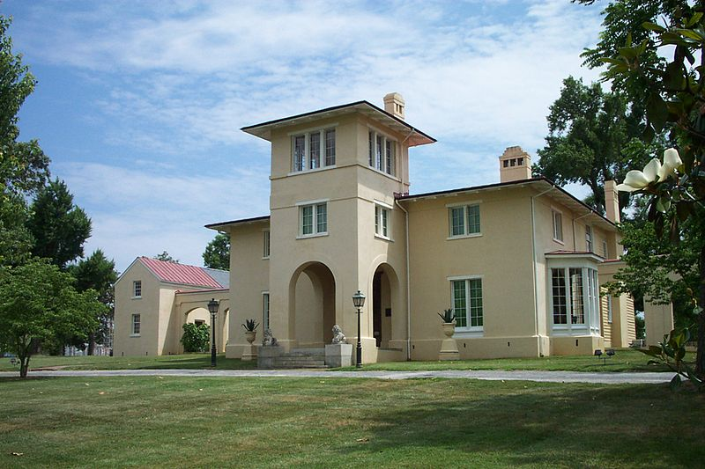
19th Century Romantic Revival: Italianate
Notes:
Constructed by Charles Bland on the crest of a hill on his wooded farm, the earliest portions of the Blandwood were completed in 1795. The simple two-story farmhouse was later purchased by Governor Morehead, and subsequently expanded according to plans drawn by nationally renowned architect Alexander Jackson Davis of New York. Davis designed additions in the Italianate style villa that featured a central tower, stucco walls, and symmetrical flanking dependencies. Completed in 1846, it is considered the oldest standing example of Italianate architecture in the United States.

Slide 14
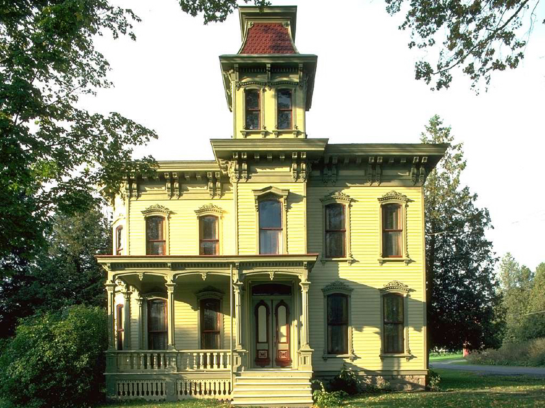
19th Century Romantic Revival: Italianate

Slide 15
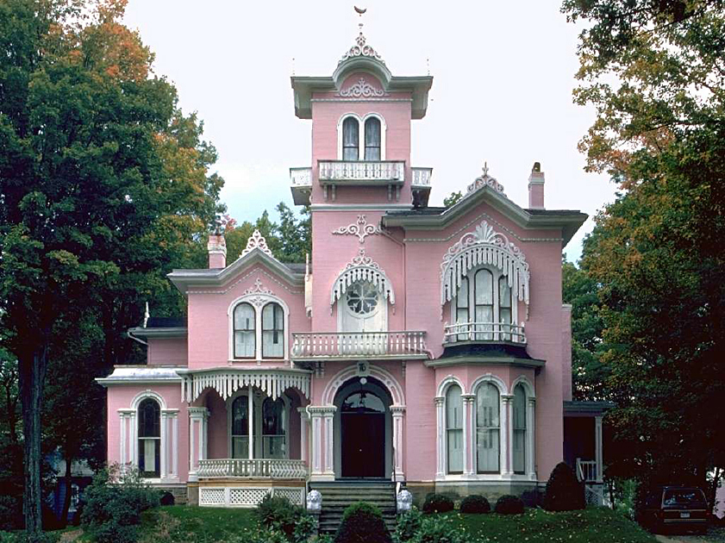
19th Century Romantic Revival: Italianate

Slide 16
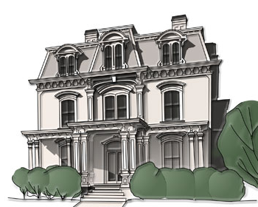
19th Century Victorian: Second Empire
Mansard roof with dormer windows on steep, lower slope
Decorative brackets beneath eaves
Molded cornices
Windows hooded
Corner quoins
Full porches common
Typically stone but also brick or wood frame
Rectangular or square towers, usually centered on the front façade
Ornate cast-iron cresting at roof ridges and tower
Came to be associated with haunted houses.

Slide 17
19th Century Victorian: Second Empire

Slide 18
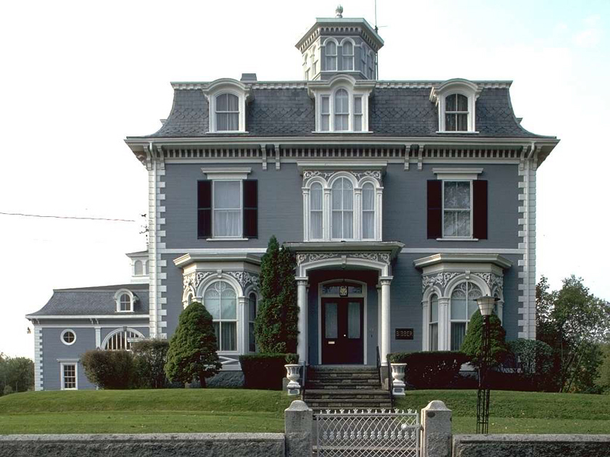
19th Century Victorian: Second Empire

Slide 19
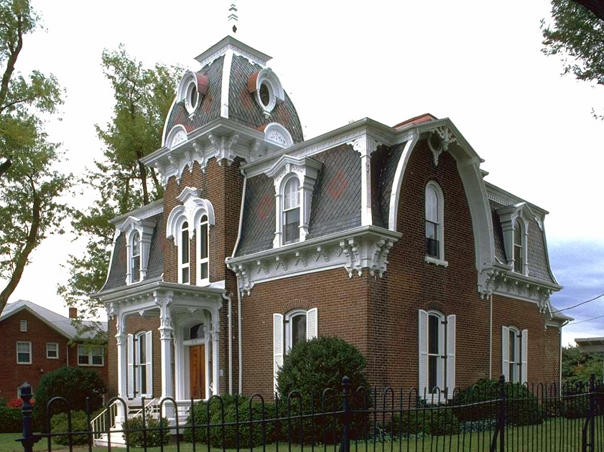
19th Century Victorian: Second Empire

Slide 20
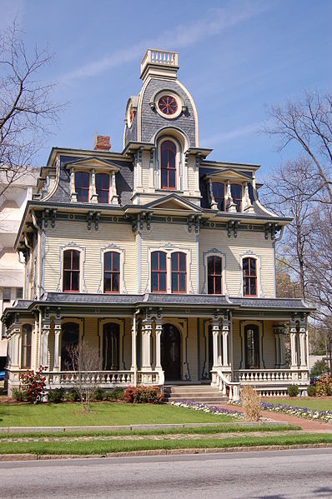
19th Century Victorian: Second Empire Heck-Andrews House in Raleigh, NC

Slide 21
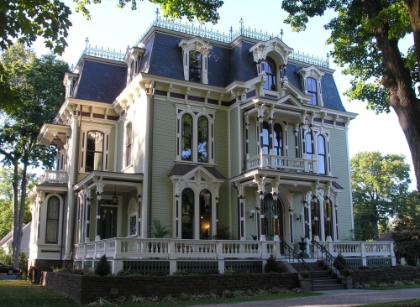
19th Century Victorian: Second Empire

Slide 22
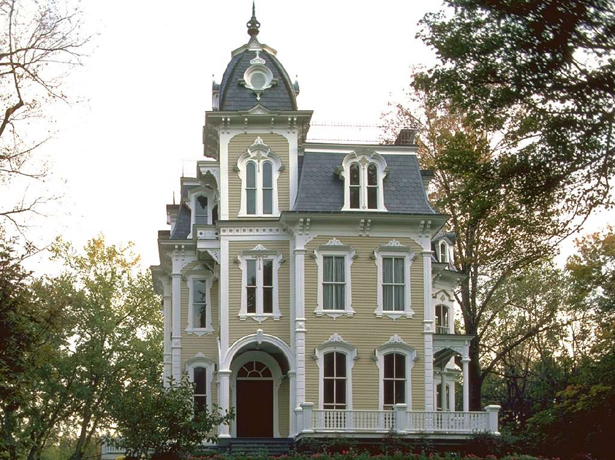
19th Century Victorian: Second Empire

Slide 23
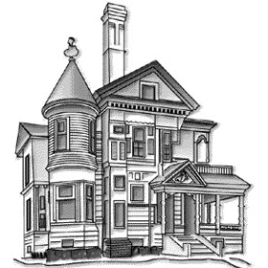
19th Century Victorian: Queen Anne
Asymmetrical two or three-storied
Complex intersecting gabled or hipped roofs
Projecting upper floors
Extensive porches
Towers and turrets
Multitude of applied features such as brackets, roof cresting, and ornamental chimneys
Textured wall patterns including decorative shingles
Lacy ornamentation around porch entries and at gable (gingerbread trim)
Windows often edged with leaded or colored glass
Rich, bold paint color schemes.

Slide 24
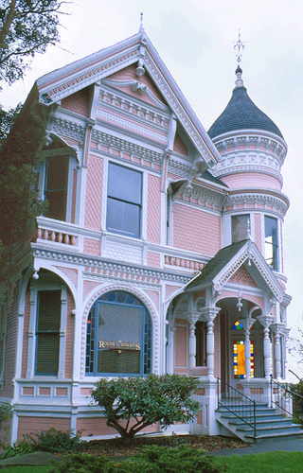
19th Century Victorian: Queen Anne

Slide 25
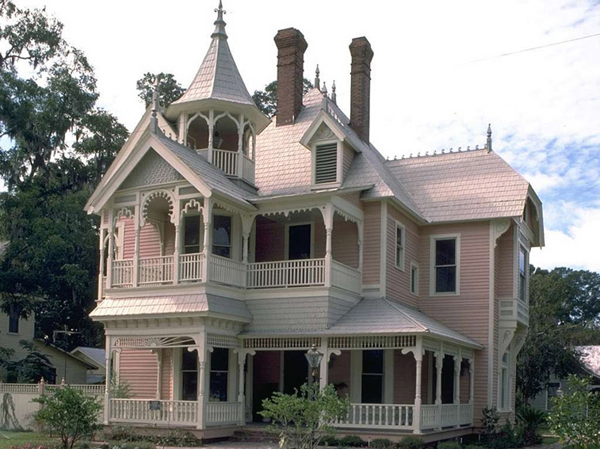
19th Century Victorian: Queen Anne

Slide 26
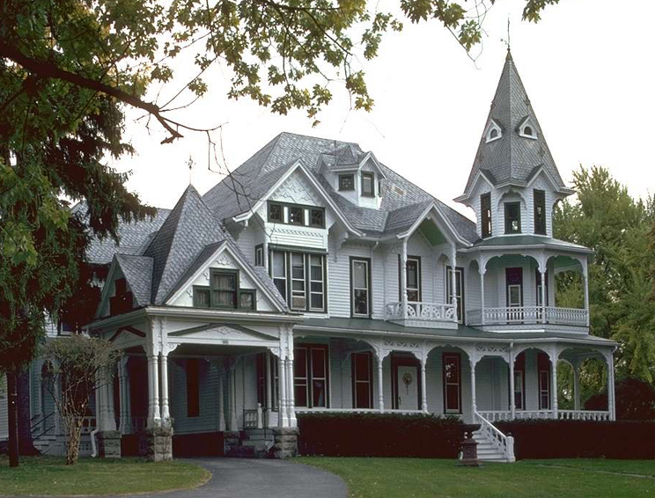
19th Century Victorian: Queen Anne

Slide 27
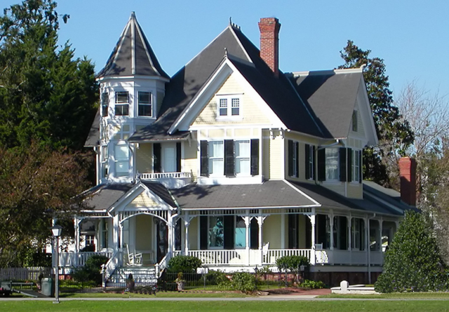
19th Century Victorian: Queen Anne

Slide 28
Resources
http://faculty.wcas.northwestern.edu/~infocom/scndempr/bedbreak/east.html
http://www.oldhouses.com/cf/archive.cfm
http://www.hillsidehistoricdistrict.com/indexSunday.htm
http://www.salemweb.com/guide/arch/houses2.shtml
http://realtormag.realtor.org/home-and-design/guide-residential-styles/art-deco

