Slide 1
Objective 6.01 Eighteenth Century Housing
Georgian
Federal
Adams
Greek Revival /Early Classical Revival

Slide 2
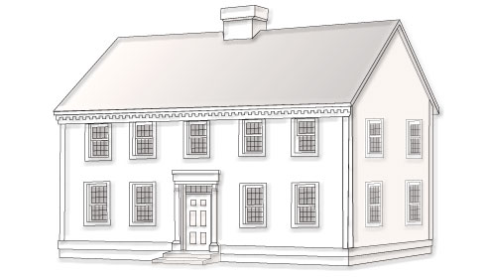
Georgian
Named for the four King Georges 1720-1840
Originals exist in the 13 colonies
Roof: hip or gable with dormers
Symmetrically centered entry
Cornice: decorative strip located where the roof and exterior wall meet
Rectangular or fanlight transom (window) above door
Pilasters: decorative flattened columns that frame doorways
Porticos: small porch leading to the entrance of the house
Pediment: triangular or arched section above door
Widow’s walk.
BASIC Georgian
HIGH STYLE Georgian

Slide 3
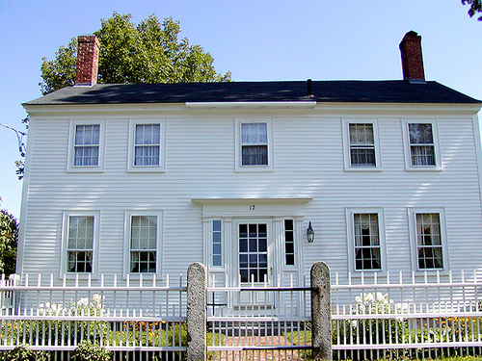
18th Century Housing: Basic Georgian Style

Slide 4
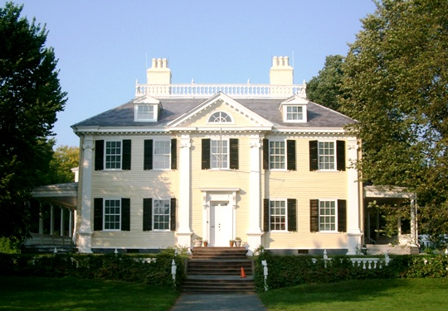
18th Century Housing: High Style Georgian

Slide 5
18th Century Housing: High Style Georgian
Stanly House built in 1780s for John Wright Stanly, a prominent New Bern citizen.

Slide 6
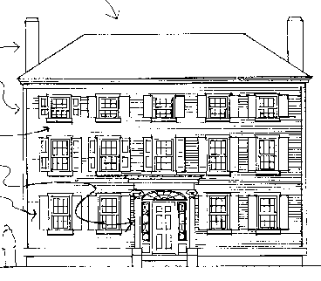
18th Century Housing: Federal Style
America wanted its “own” style; popular just after Revolutionary War; reflects anti-English thought
2-3 stories high
Low-pitched roof or flat roof with a balustrade
Dentil moldings in cornice
Windows arranged symmetrically around a center doorway
Decorative crown or roof over front door
Semicircular fanlight over front door
Narrow sidelights flanking front door
Lower windows taller than uppers
Palladian, circular, or elliptical windows often used.

Slide 7
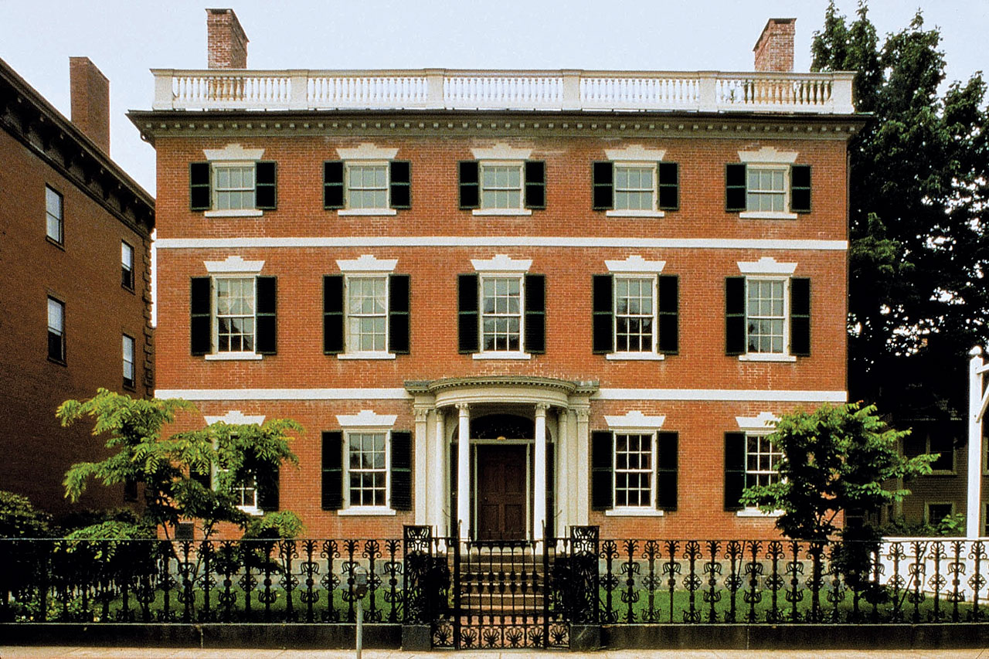
18th Century Housing: Federal Style

Slide 8
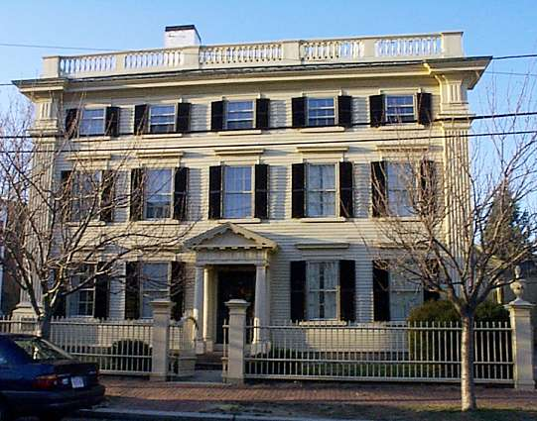
18th Century Housing: Federal Style

Slide 9
18th Century Housing: Adam Style
Refinement of the Georgian style; appears lighter and more delicate
Cornice emphasized by decorative moldings
Semi-circular or elliptical fanlight over the front door, with or without side lights; may include a decorative crown or small entry porch
Three part Palladian-style windows.

Slide 10
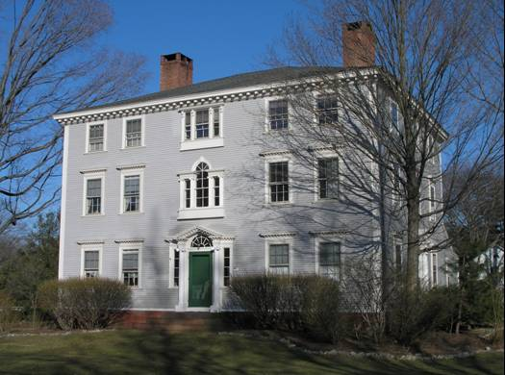
18th Century Housing: Adam Style

Slide 11
Greek Revival / Early Classical Revival
Popular just before Civil War; associated with classical thought and democracy
Gable roof with front orientation or hipped roof of low pitch
Heavy entablature and cornices
Small frieze-band windows below cornice
Generally symmetrical, though entry is often to one side
Front door surrounded by narrow sidelights and rectangular transom
Porticos with prominent columns.

Slide 12
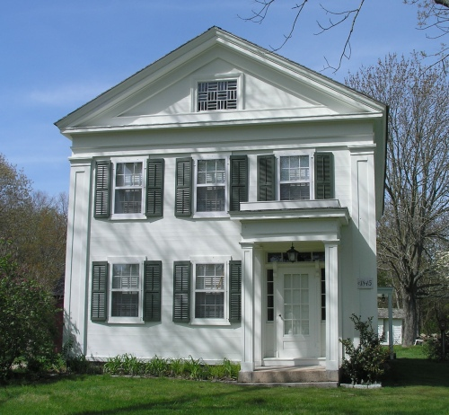
18th Century Housing: Greek Revival

Slide 13
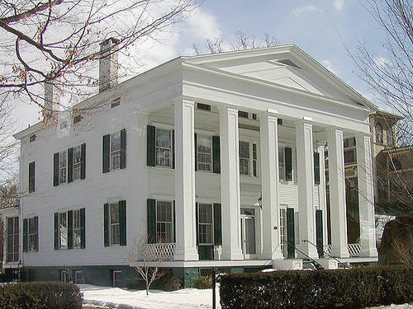
18th Century Housing: Greek Revival

Slide 14
Resources
http://english.fju.edu.tw/lctd/asp/periods/5/america/concept.htm
http://ncpedia.org/architecture/overview
http://www.historicnearwestside.com/architecturestyles.htm
http://architecture.about.com/cs/teacherstools/a/architecture101.htm
http://architecture.about.com/library/bl-styles_index.htm
http://www.architecturetoursla.com/gallery.htm
http://www.bc.edu/bc_org/avp/cas/fnart/fa267/contents.html
http://www.greatbuildings.com/types.html
http://www.infoplease.com/encyclopedia/1arch.html
http://www.loggia.com/designarts/architecture/styles/styleguide.html
http://www.preservationdirectory.com/HistoricalPreservation/Home.aspx
http://www.uwec.edu/geography/Ivogeler/w367/styles/

