Slide 1
Objective 6.01 Early American Housing – 1640-1720
English Influence
Half timbered
Cape cod
Saltbox
Garrison
German Influence
Dutch Influence
Spanish Influence
French Influence
Swedish/Scandinavian Influence

Slide 2
English Influence: Half-Timbered
Exposed wood framing
Spaces between the wooden timbers are filled with plaster, brick, or stone.

Slide 3
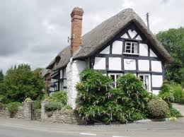
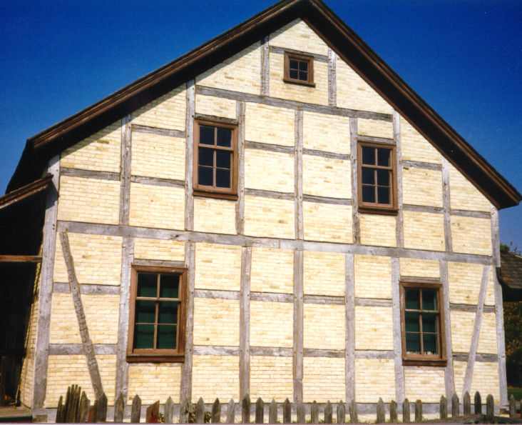
English Influence: Half-Timbered

Slide 4
Jamestown, VA and Plymouth, MA

Slide 5
English Influence: Cape Cod
Simple symmetrical design
Central front door
Multi-paned windows and a steep pitched roof.

Slide 6
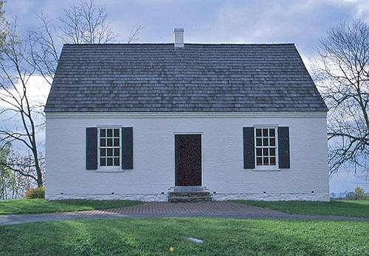
English Influence: Cape Cod

Slide 7
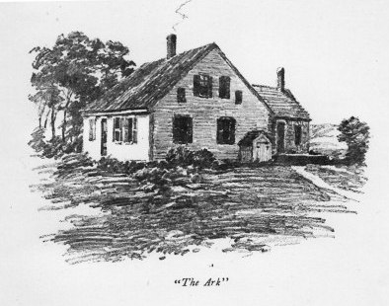
Cape Cod with Ell
Ell (a building addition at a right angle to the main structure) added later to provide more space.

Slide 8
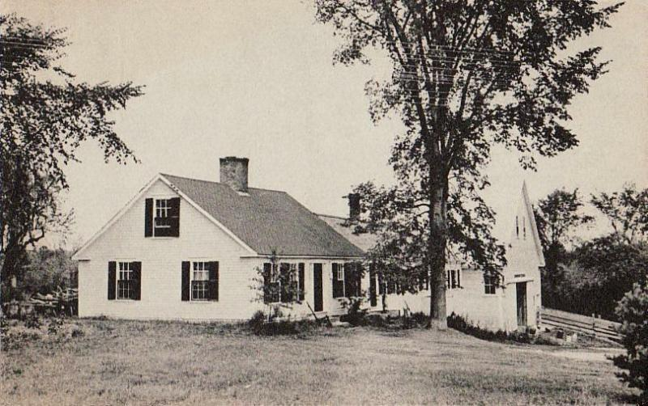
Cape Cod with Ell

Slide 9
New England: Maine, New Hampshire, Vermont, Massachusetts, Rhode Island and Connecticut

Slide 10
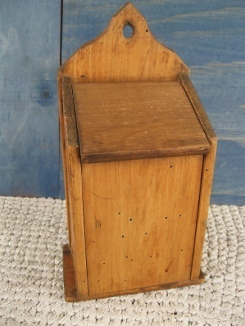
English Influence: Saltbox
Long, pitched roof
One story in the back and two in the front
Flat face and central chimney
Designed after English salt box keepers.

Slide 11
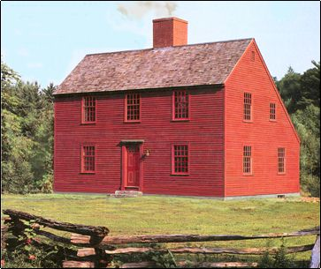
English Influence: Saltbox

Slide 12
Original 13 Colonies: New Hampshire, Massachusetts, Rhode Island, NY, Pennsylvania, Connecticut, New Jersey, Delaware, Maryland, Virginia, NC, SC, GA

Slide 13
English Influence: Garrison
Garrison means “a strong structure”
Two stories with the second-story overhanging in the front.

Slide 14
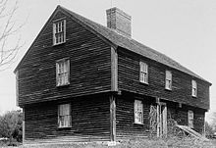
English Influence: Garrison

Slide 15
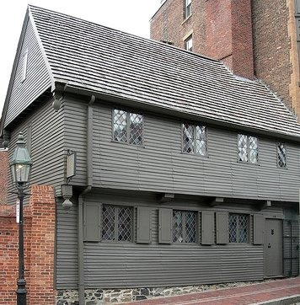
Garrison (Paul Revere House)

Slide 16
Original 13 Colonies: New Hampshire, Massachusetts, Rhode Island, NY, Pennsylvania, Connecticut, New Jersey, Delaware, Maryland, Virginia, NC, SC, GA

Slide 17
Dutch Influence
Dormers to add light, ventilation, and more useable space to the attic area
Gambrel roofs with curved eaves along the edges of the house
Usually made of stone or brick.

Slide 18
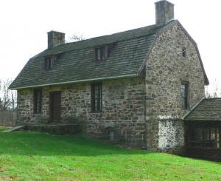
Dutch Influence: Dutch Colonial

Slide 19
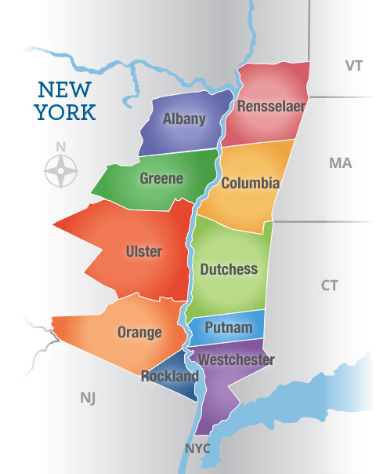
New York, especially the Hudson Valley

Slide 20
German Influence
Also called Pennsylvania Dutch Colonial
Exteriors of wood or stone
Gable roofs
Roof between floors (pent roof).

Slide 21
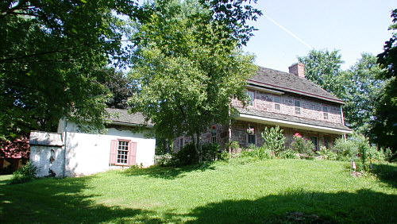
German Influence: Pennsylvania Dutch
Gerhard IndenhofenHouse

Slide 22
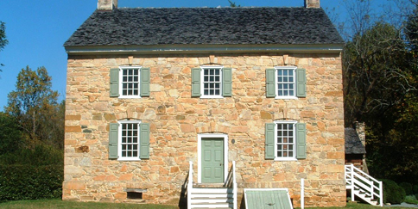
German Influence: Hezekiah Alexander House Charlotte, NC

Slide 23
Pennsylvania

Slide 24
Spanish Influence
Low-pitched tile roofs
Exteriors made of coquina (soft limestone made of shell and coral) or stucco.

Slide 25
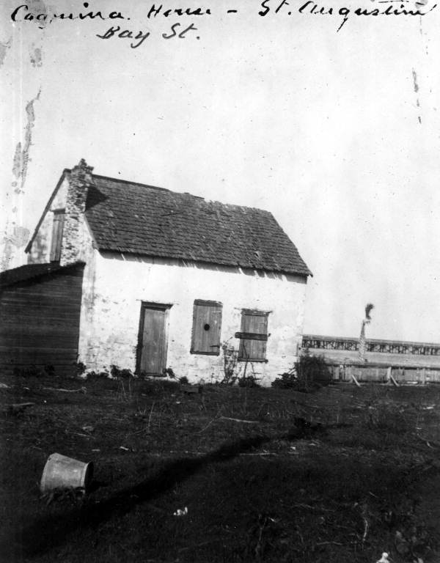
Spanish Influence
The oldest Spanish house in existence in the United States today is located in Florida and was built with coquina
State Archives of Florida, Florida Memory, http://floridamemory.com/items/show/31716

Slide 26
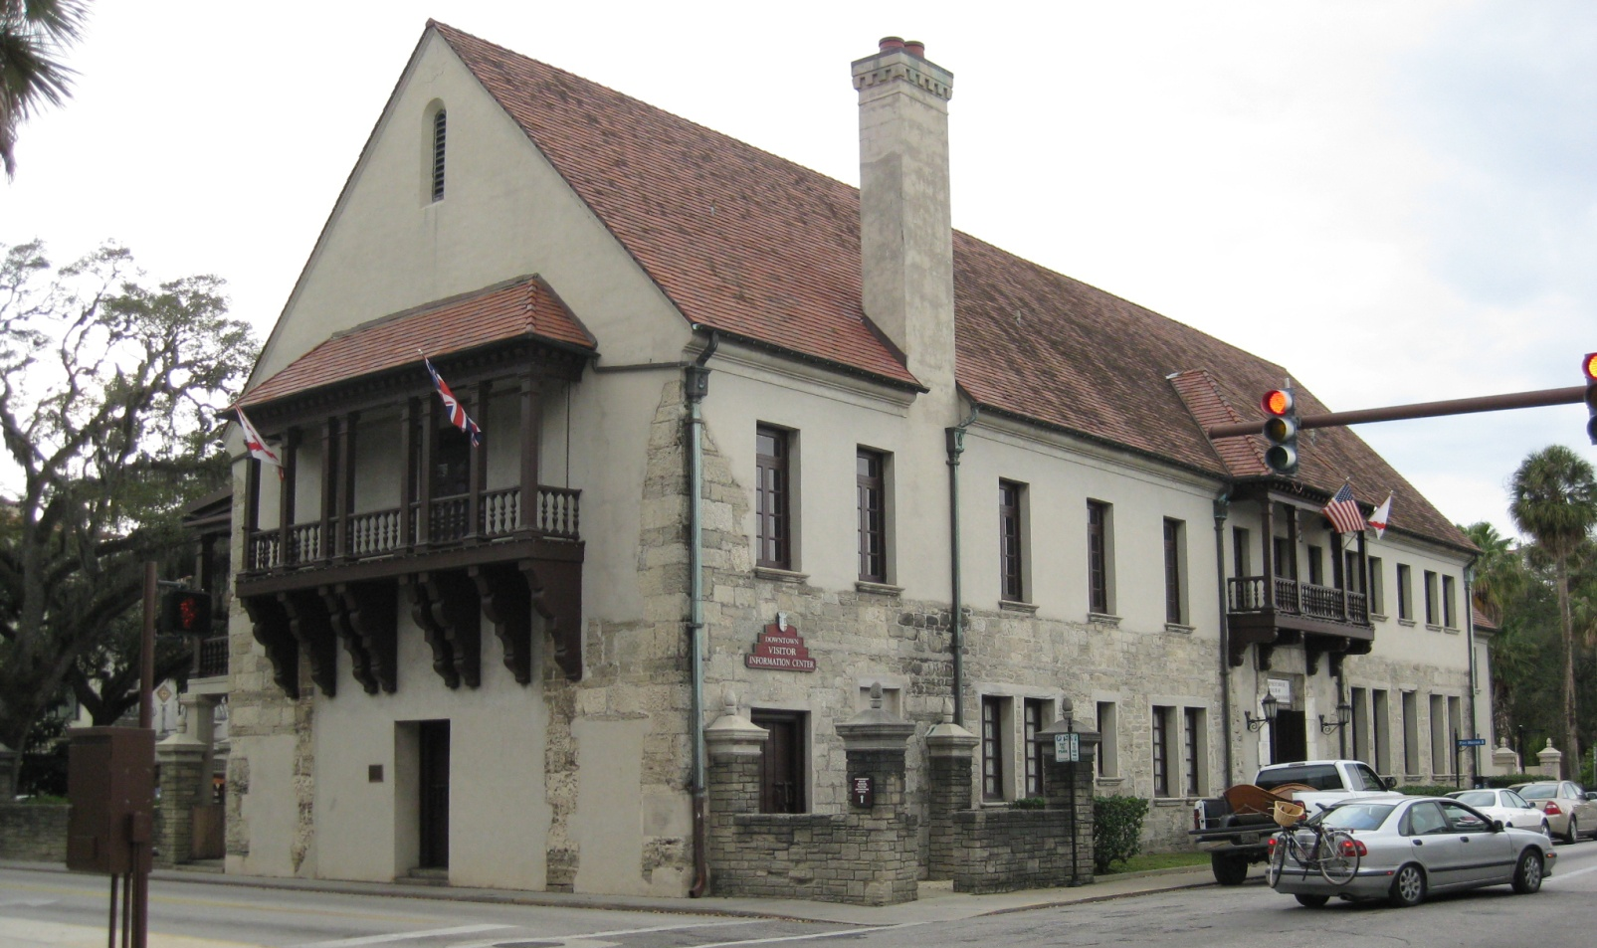
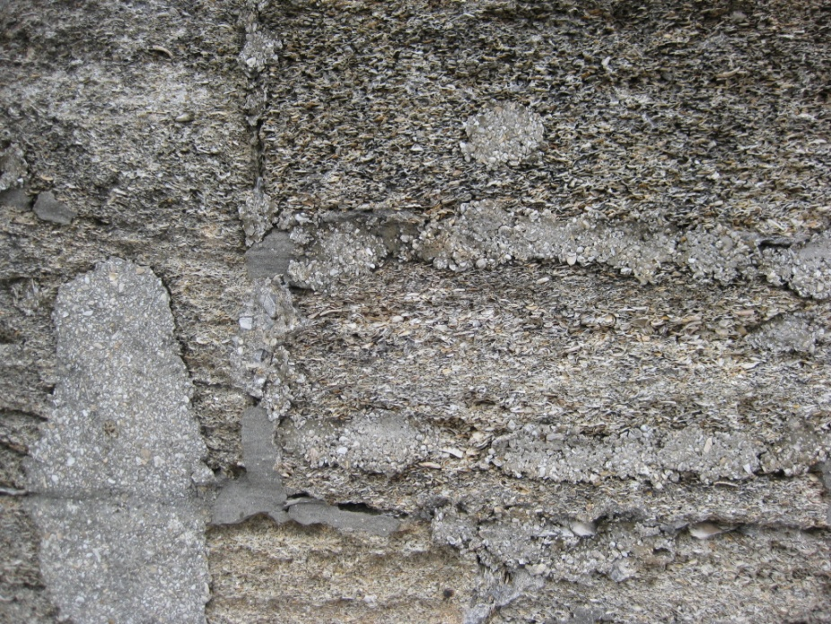
Spanish Influence: Coquina

Slide 27
Florida

Slide 28
French Influence
French influenced many American architectural styles depending on the section of the country
General characteristics are
Steep hip roof
Small windows
Heavy wood shutters
Other characteristics vary with the area of the US in which they are located.

Slide 29
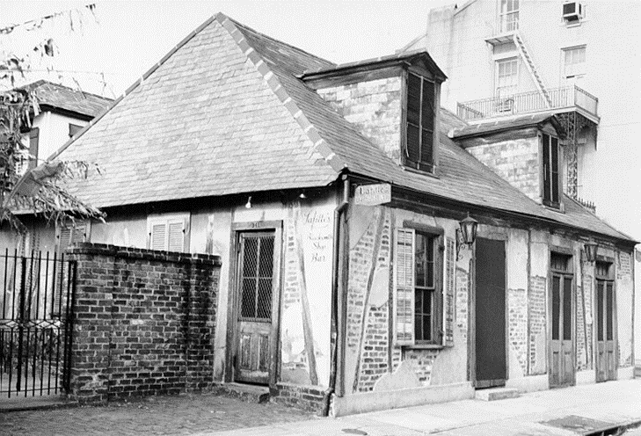
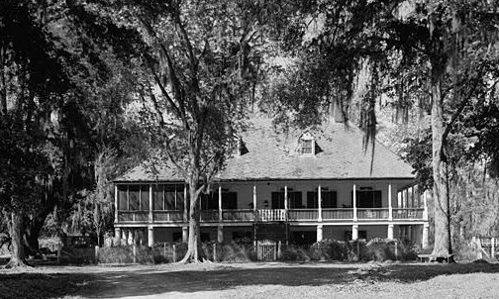
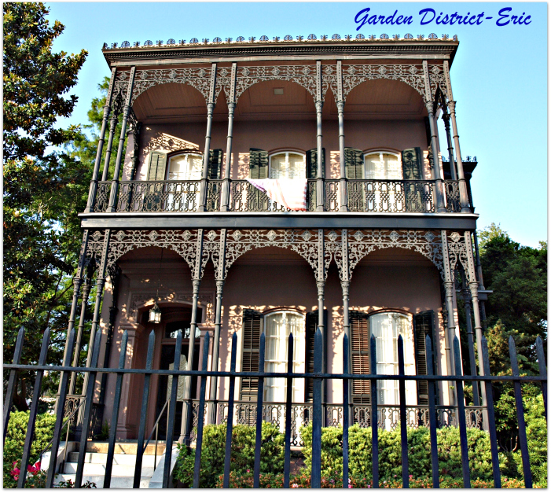
Louisiana French
Early American: French Influence:
French Manor House
French Plantation

Slide 30
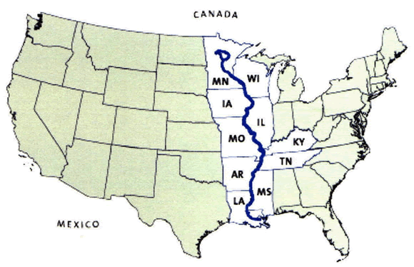
Along Mississippi River Valley from Canada to Louisianna

Slide 31
Swedish/Scandinavian Influence: Log Cabin
One room home made from bulky unshaped lumber
Unfinished log exterior walls
One story and rectangular
Few windows
Gable roofs

Slide 32
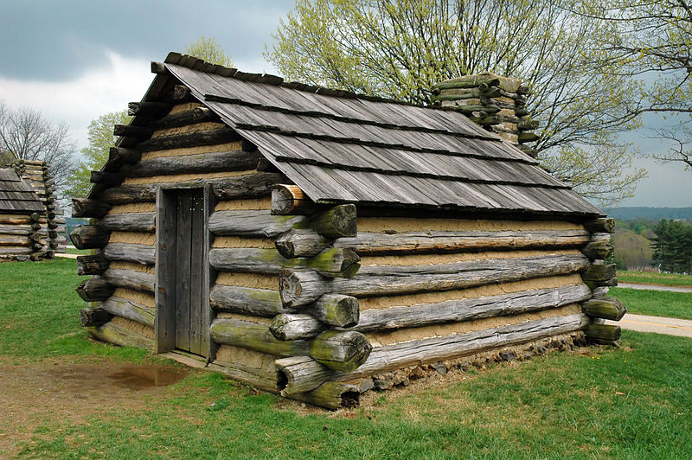
Swedish/Scandinavian Influence: Log Cabin

Slide 33
Delaware, New Jersey, Pennsylvania, and Maryland

