Slide 1
Objective 6.01 Native American Housing
Native American Housing
Tepee
Pueblo (adobe)
Wigwam
Longhouse

Slide 2
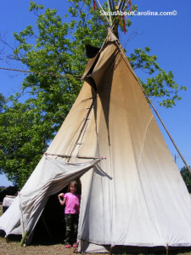
Tipi, teepee, or tepee
3 or 4 poles lashed together at the top to form a cone shape then covered with hides
Portable
Entrance faced east to get the morning sun.

Slide 3
Tipi, teepee, or tepee - Great Plains (Montana, Wyoming, Colorado, New Mexico, North Dakota, South Dakota, Nebraska, Kansas, Oklahoma)

Slide 4
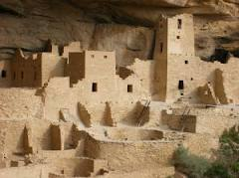
Pueblo
Multi-level homes built on top of each other into cliffs, caves, and on level ground
Made from adobe bricks.

Slide 5
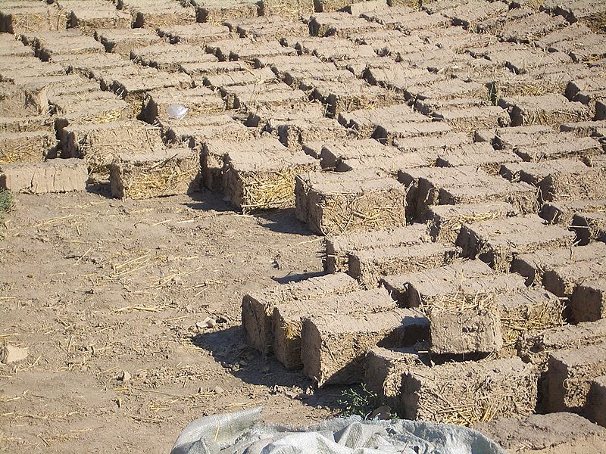
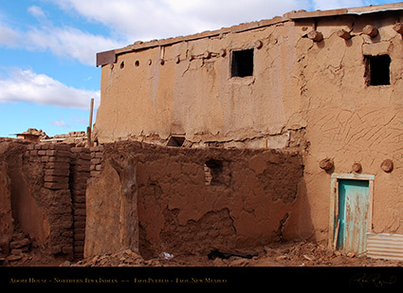
Adobe (means “mud brick”)
Made from sand, clay, water, and organic material (sticks, straw, and/or manure), which builders shape into bricks and dry in the sun
Extremely durable and account for some of the oldest existing buildings in the world.

Slide 6
Pueblo - Southwest (California, Nevada, Utah, Arizona, Colorado, New Mexico, Oklahoma, Texas)

Slide 7
Mesa Verde in Colorado

Slide 8
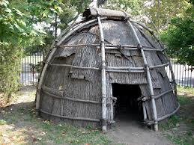
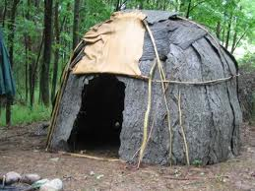
Wigwam
A frame of arched poles covered with a roofing material made of grass, brush, bark, cloth, etc depending on the availability of materials
Not portable but easy to construct.

Slide 9
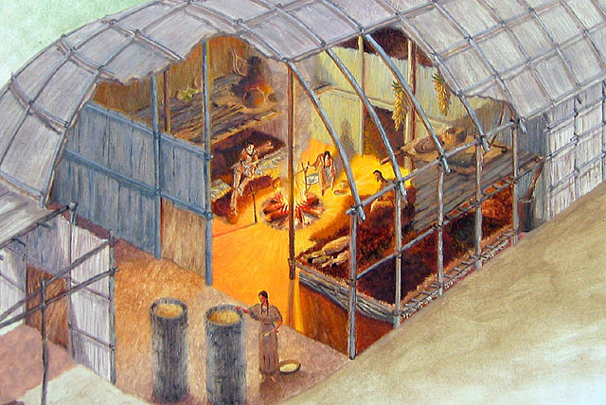
Longhouse
Construction similar to wigwam but larger and takes more time to build
Permanent dwelling meant to house multiple families.

Slide 10
Wigwam and Longhouse – Northeast Maine, New Hampshire, Vermont, Massachusetts, Rhode Island, New York, Connecticut, Pennsylvania, New Jersey

