Slide 1
4.02: Applying Principles and Elements of Design

Slide 2
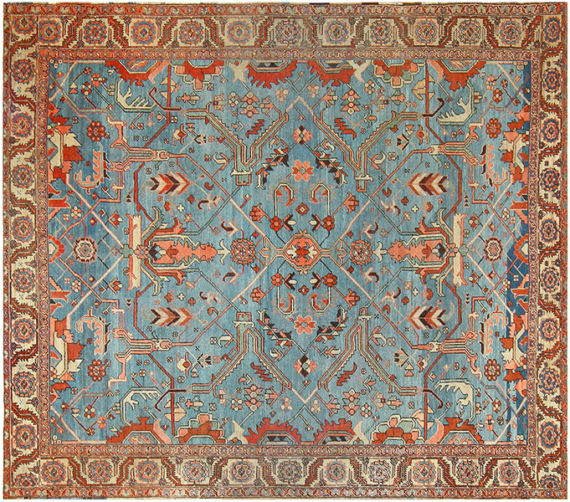
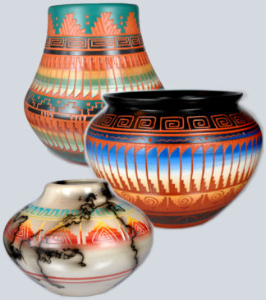
Choose a theme or color scheme based on:
An existing piece that provides inspiration
Art
Pottery
Rug

Slide 3
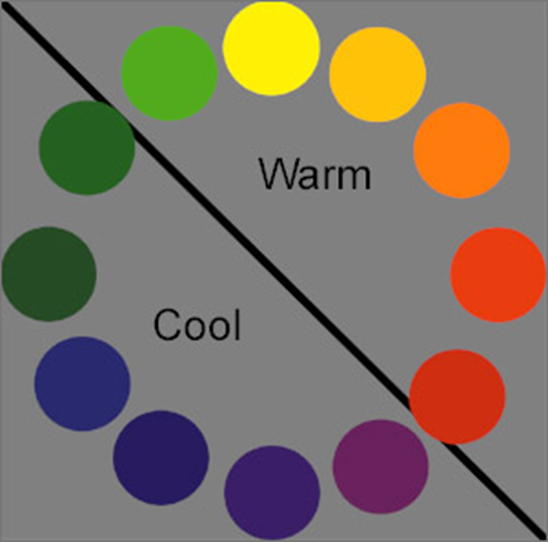
When choosing colors consider color temperatures

Slide 4
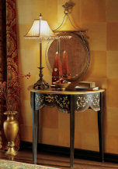
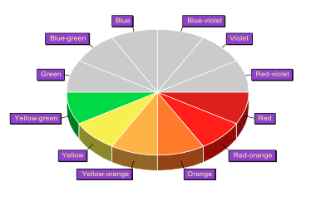
Warm Colors
Reds, yellows, and oranges
Warm colors advance and make walls appear closer to you than they really are
Warm colors make a space appear smaller.

Slide 5
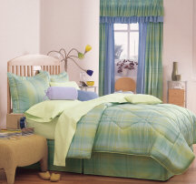
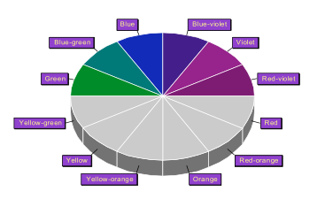
Cool Colors
Blues, violets, and greens
Cool colors recede and make walls seem farther away than they really are
Cool colors make a space appear larger.

Slide 6
When choosing colors consider amount and type of light
North: no direct natural light
South: full sun
East: morning sun
West: afternoon sun

Slide 7
Every fabric fits into one of 3 groups: organic, geometric, and neutral.

Slide 8
Choosing coordinating fabrics is much like designing a wedding…

Slide 9
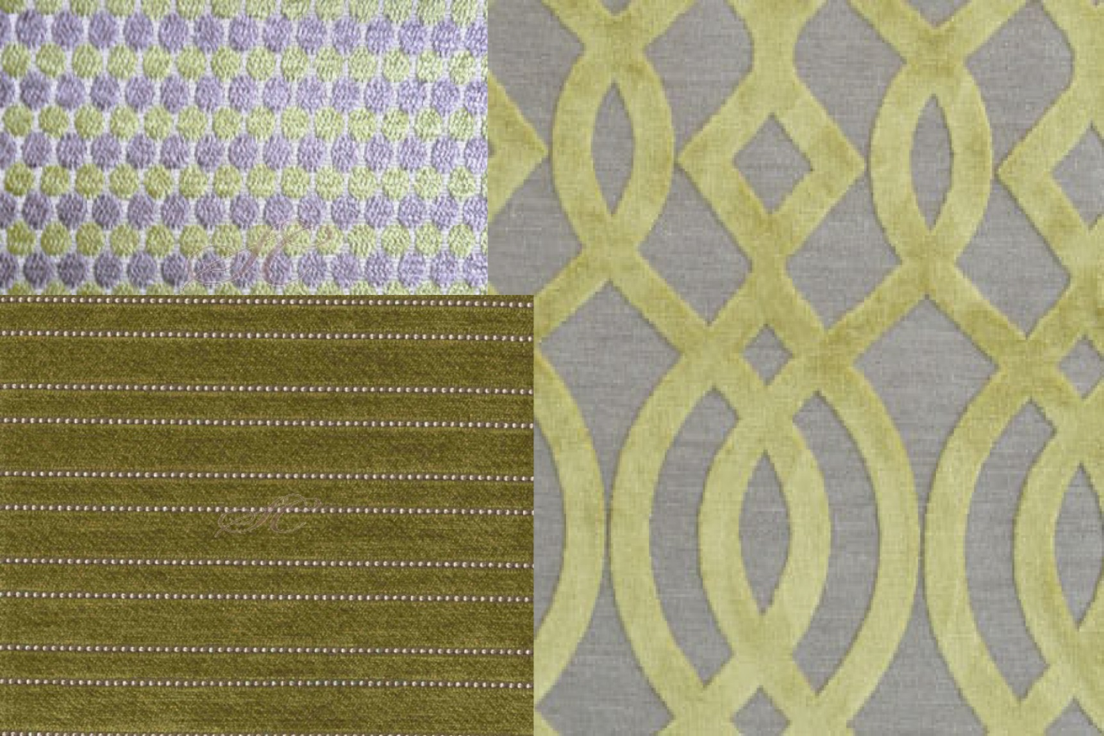
PATTERN 1: Select a “primary” fabric which is the “bride”. Choose a large scale pattern. This fabric gets the most attention so make it something you love.

Slide 10
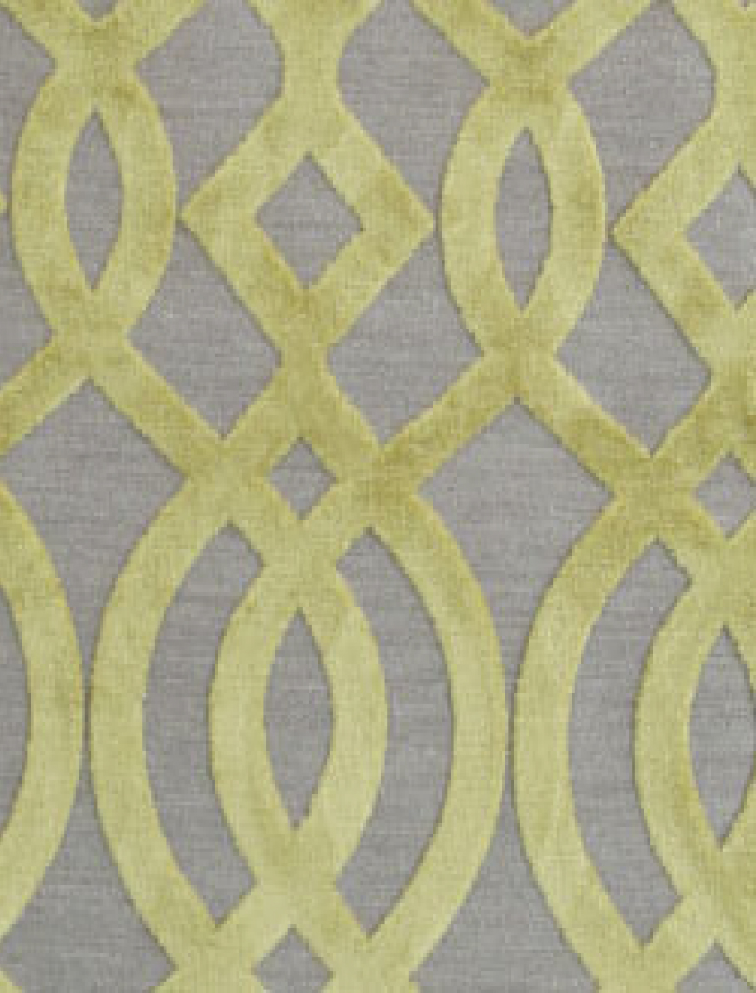
PATTERN 2: Select a “bridesmaid” fabric. This piece should have a couple of the same colors as your “bride”. The pattern should be half the scale of the “bride”.

Slide 11
PATTERN 3: Select a “groom”. Combine your first two selections with a solid. Solid fabrics may contain subtle patterns within them, such as small diamond shapes or a tone-on-tone.

Slide 12
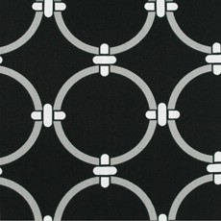
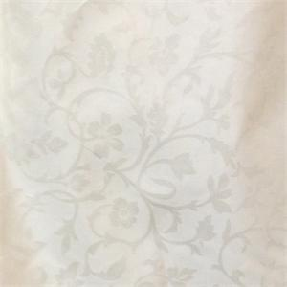
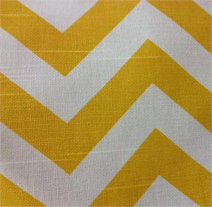
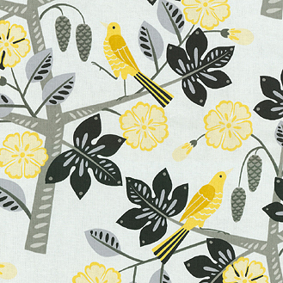
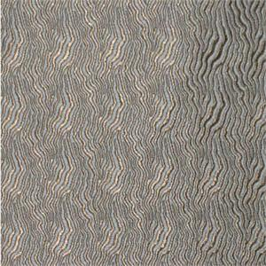
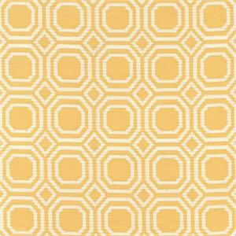
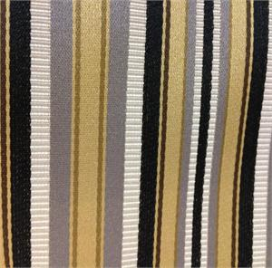
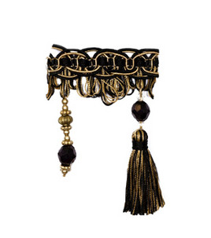

Slide 13
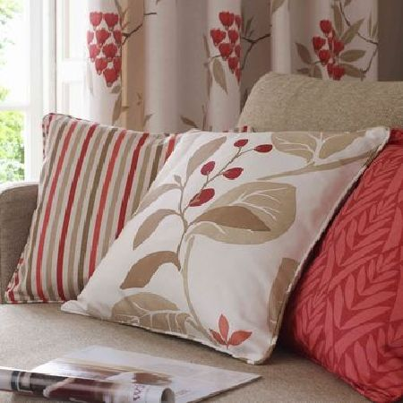

Slide 14
Choosing Color: 60 – 30 – 10 Rule

Slide 15
Use the 60-30-10 rule to decide how much of each color to use in a scheme.
When decorating a room, divide the colors into percentages:
60% of a dominant color
30% of a secondary color
10% of an accent color
Translated to a room setting, it typically means:
60% of the room's color is the walls
30% of the room's color is the upholstery
10% of the room's color is an accent piece or a floral arrangement

Slide 16
