Slide 1
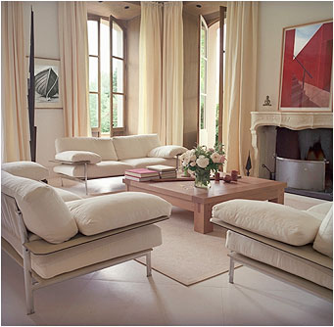
4.01 Principles of Design

Slide 2
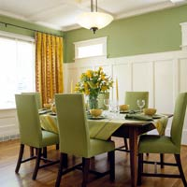
Principles of Design – Your Rules
Proportion
Scale
Balance
Rhythm
Emphasis
Harmony

Slide 3
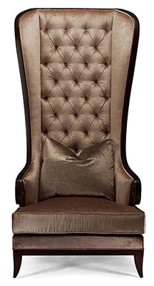
Proportion
Proportion is the size relationship within an object or design
Out of proportion is NOT pleasing to the eye.
Notes:
You have seen examples of an object out of proportion, I’m sure. When it happens, the eye is not pleased. A common one is hanging a small picture on a large wall creating too much negative space. The ratio of positive space to negative space is grossly disproportionate causing the entire wall to appear cold or underdeveloped. A larger picture, grouping compatible pictures together, or anchoring the small picture with a piece of furniture are some methods of solving this example problem.

Slide 4

OUT OF PROPORTION!

Slide 5
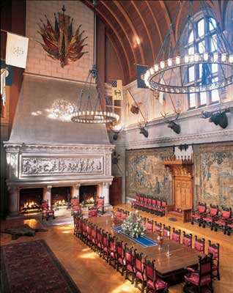
Scale
A room is in SCALE when the dimensions of the objects in the entire room are harmonious.
Notes:
. For example, in general, large scale furniture and motifs do well in large scale rooms. When you move from a smaller home into a larger one, you may think, ‘My furniture seems so small.’ It is not that your furniture is ‘small’; it is just not in scale with the size of the room.

Slide 6
Out of scale!

Slide 7
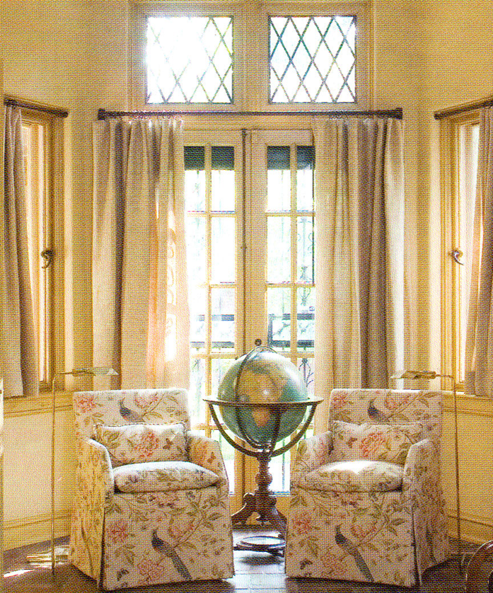

Balance
Symmetrical (Formal) Balance: the 2 sides of the room form a mirror image.
Notes:
). Symmetry has a more formal appearance and feel, for example bookcases flanking the door of a den. Balancing with asymmetry is more difficult to accomplish as the eye is used to create it but the results can be wonderful.

Slide 8
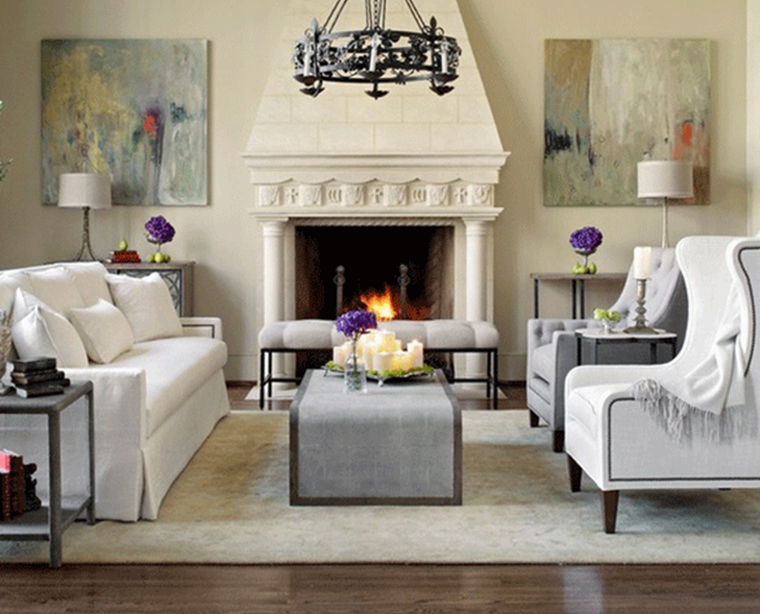

Balance
Asymmetrical (Informal) Balance: the room appears balanced but the 2 sides are not identical.
Notes:
). Symmetry has a more formal appearance and feel, for example bookcases flanking the door of a den. Balancing with asymmetry is more difficult to accomplish as the eye is used to create it but the results can be wonderful.

Slide 9
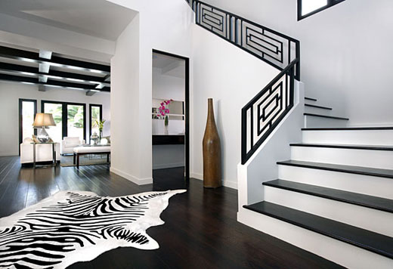
Rhythm
Rhythm moves the eye from one area to another.
Notes:
Recall the discussion of public versus private space. Rhythm is the flow of elements usually organized according to a scheme such as repetitive pattern. You can have a lot of fun creating rhythm. I used a diamond pattern in the window treatments and decorative pillows for a client’s master bedroom. She not only embraced this concept but added crystal pieces in the room to have it figuratively and literally sparkle.

Slide 10
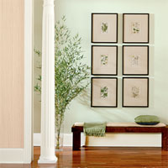
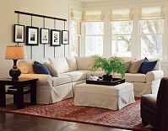
Repetition - repeating colors, lines, forms, or textures.
Rhythm

Slide 11
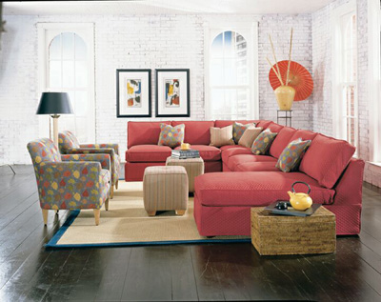
Opposition – lines meeting to form right angles.
Rhythm

Slide 12
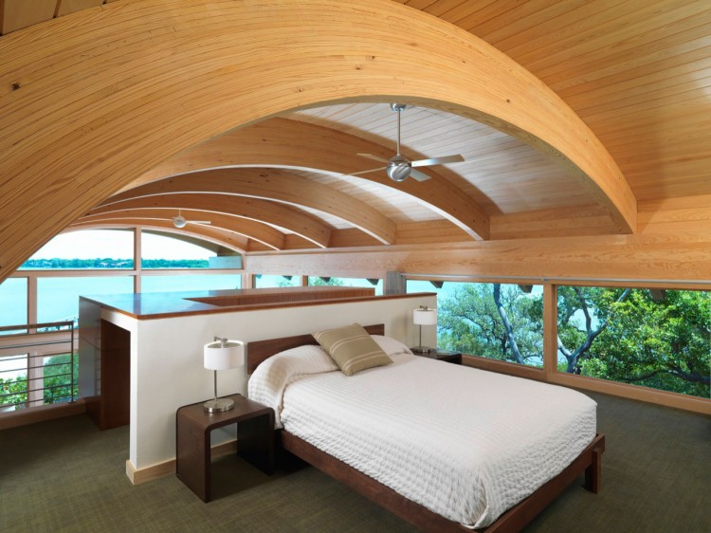
Transition – curved lines leading your eye from one part to another.
Rhythm

Slide 13
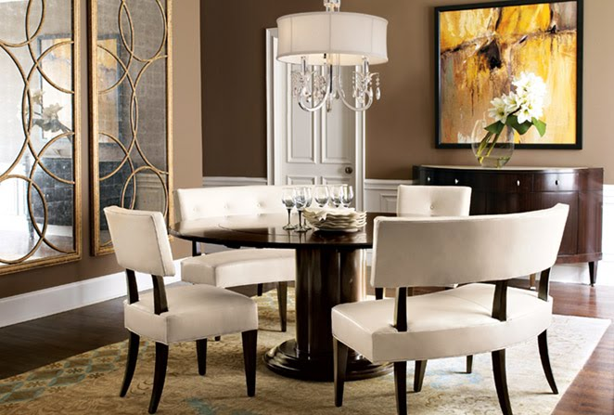
Radiation - lines move outward from a central point.
Rhythm

Slide 14
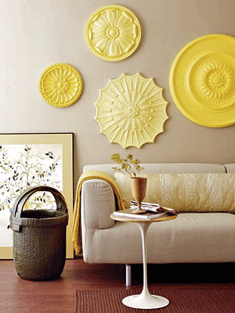
Gradation - gradual increase or decrease of color, size, or pattern.
Rhythm

Slide 15
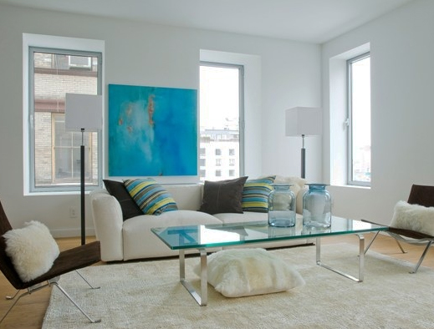
The focal point that first catches the viewer’s attention.
Emphasis
Notes:
. A fireplace in a family room will likely be the focal point of that room. There also may be a media center as a secondary point of interest. Furniture will be arranged such that your eye will be guided toward the focal points; in this example, toward the fireplace or a media center.

Slide 16
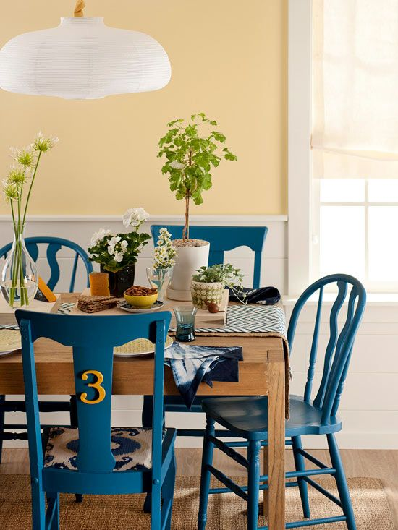
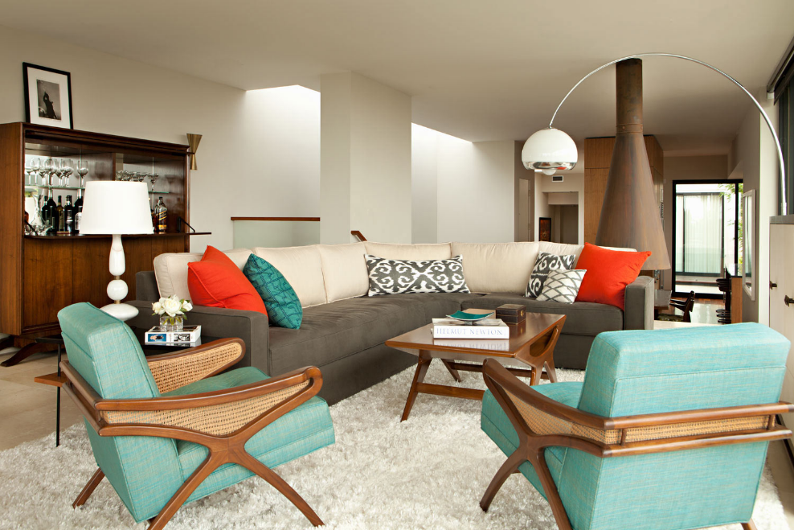
Harmony
When all parts of a design “agree” either through UNITY or through VARIETY.
Notes:
For example, I’ve used the color red, a warm hue, as a flow element in my home. I have used neutral and cool hues also throughout to add interest and diversity; too much of a good thing can actually become monotonous over time.
For example, I’ve used the color red, a warm hue, as a flow element in my home. I have used neutral and cool hues also throughout to add interest and diversity; too much of a good thing can actually become monotonous over time.

Slide 17
Unity - when all the parts of a design are related by one idea.
Harmony

Slide 18
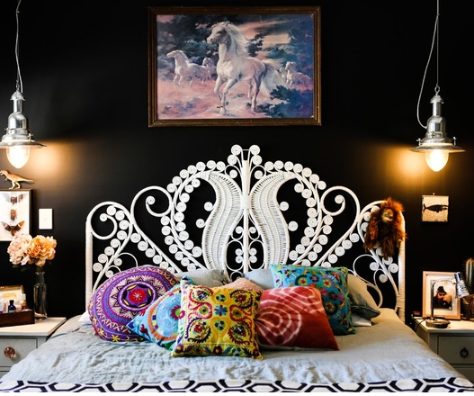
Variety - combining different styles and materials together.
Harmony

Slide 19
Principles of Design
PROPORTION
SCALE
BALANCE
RHYTHM
EMPHASIS
Harmony

