Slide 1
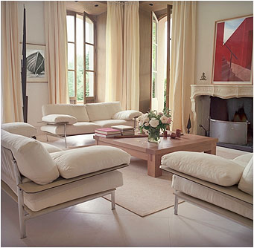
4.01 Elements of Design – Your Tools

Slide 2
Line
Form
Space
Mass
Texture
Color

Slide 3
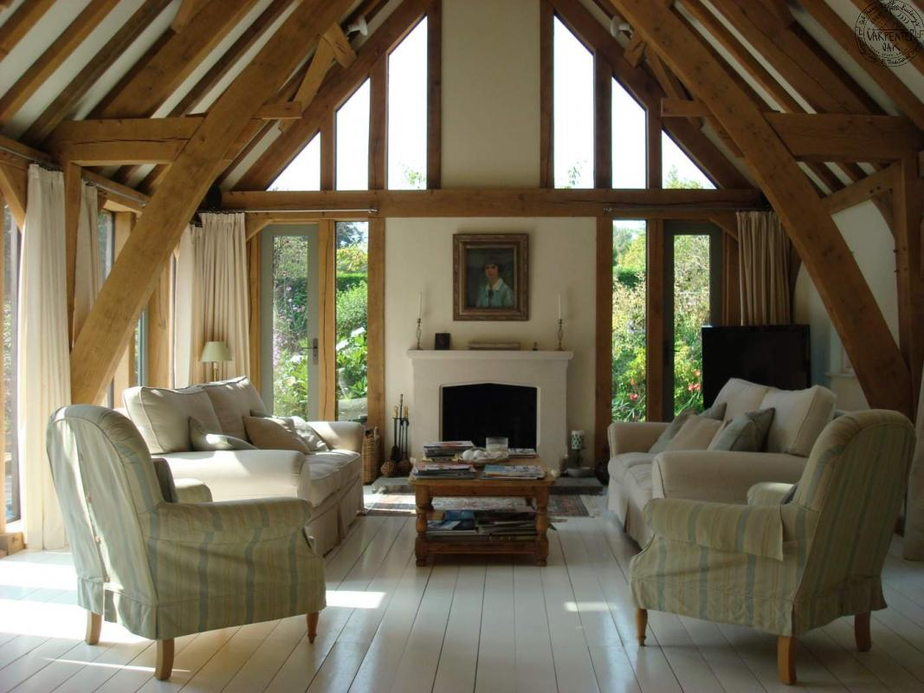
Line
Line– creates direction and movement
Line communicates:
horizontal (relaxation)
vertical (strength, dignity)
diagonal (action)
curved (calmness, softness).

Slide 4
Line
The most pleasing effect will have:
a balanced mixture of lines
one type of line taking the lead role
the “lead” line chosen based upon the feeling to be achieved.

Slide 5
Form
Form is the PHYSICAL SHAPE of objects
It contains volume and mass (height, width, and depth).
Notes:
With shape and form, think of those pleasing to the eye and that are well proportioned and complement each other. If you like geometric forms, you’ll need to soften it by adding curved pieces. This will accomplish balance and harmony and ultimately a more comfortable feel.

Slide 6
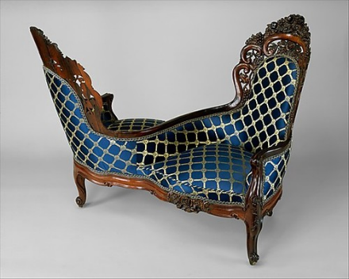
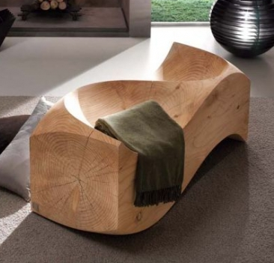
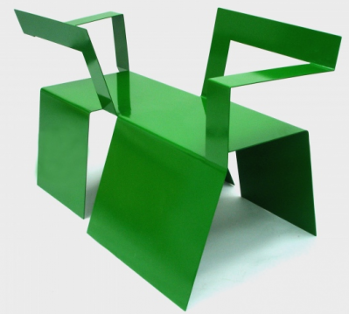
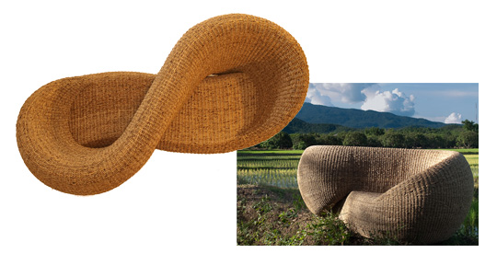
Form
Form can be:
Realistic – when it looks very much like the real thing
Abstract – when it rearranges or stylizes a recognizable object
Geometric – when it uses squares, rectangles, circles etc.
Free Form – random and flowing

Slide 7
Remember:
The FUNCTION of an item should be considered first before its form
RELATED forms are more agreeable than unrelated forms
A GRADUAL CHANGE in form smoothly directs the eyes.
Form

Slide 8
Space
Two types of space:
Filled area is positive space
Unfilled area is negative space
Rooms need both of these in balance.
Notes:
. Incorporate both, or the appearance of both, in your home. Traffic paths are negative space in a room yet functionally important. An example of too much positive space is filling a small room with oversized furniture. You can use large pieces in a small room balanced by massing, placing together, smaller scale items that allow for more negative space in between (this is also an example of asymmetrical balance).

Slide 9
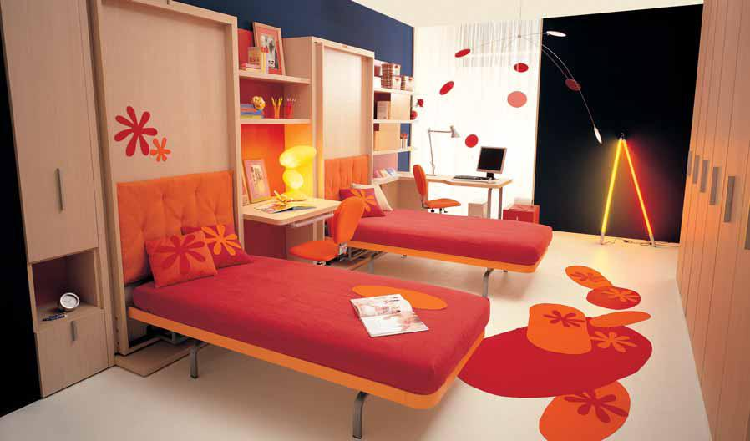
The size or amount of space taken up by the elements
A space can be high mass or low mass.
Mass

Slide 10
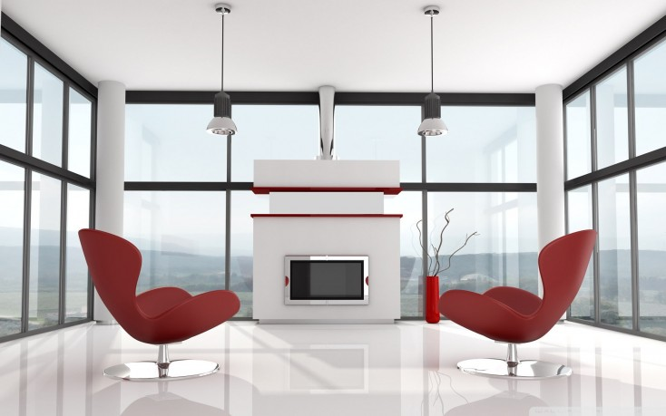
Low mass space: relaxing, peaceful
Mass

Slide 11
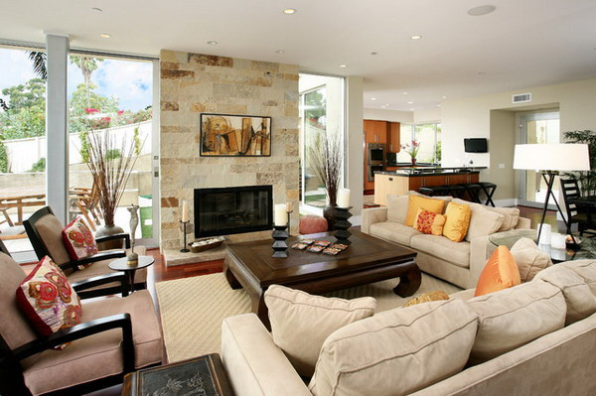
High Mass Space: busy, enhances conversation
Mass

Slide 12
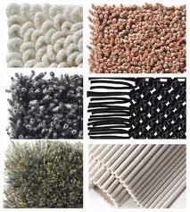
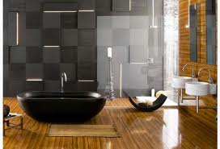
Texture
The way a surface feels (TACTILE) or appears to feel (VISUAL).
Notes:
All fabric has texture but a faux wall treatment can also give the appearance of a texture when, to the touch, it may be completely smooth. The textures of fabric and treatments need to be compatible but varied for harmony. In a monochromatic room, texture is a critical element to plan for and vary to please the eye and maintain attraction.

Slide 13
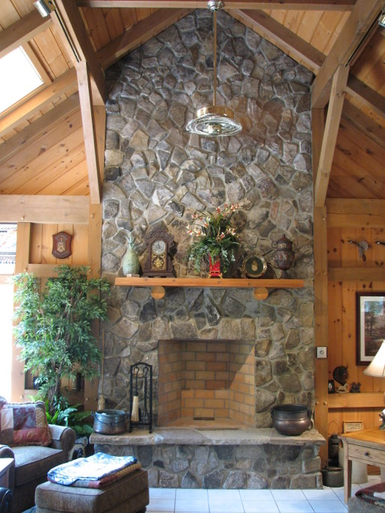
Texture
Tactile Texture

Slide 14
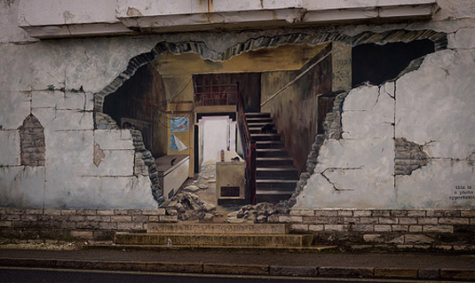
Texture
Visual Texture

Slide 15
Element of Color
Color is the most significant element of design
Color can be used to express a person’s individuality or to create a certain mood or illusion
Color can make a warm room seem cooler and make a cool room seem warmer.

Slide 16
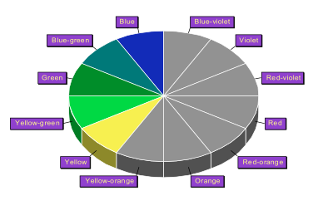
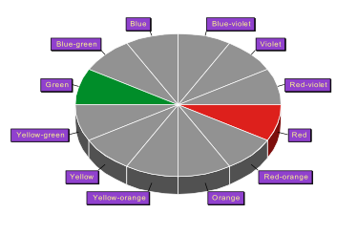
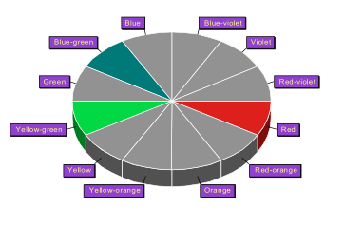
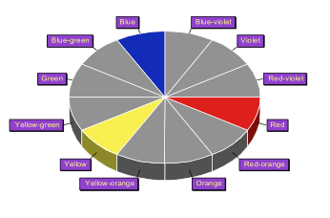
Element of Color
Monochromatic – varying values of one hue
Analogous – 3-5 hues beside each other on the color wheel
Complementary – opposite hues on the color wheel
Split complementary - one hue and the two hues on each side of its complement
Triadic - three hues equally spaced on the color wheel.

Slide 17
The Psychology of Color
Color influences human behavior
Social areas should be decorated in colors that make all members feel comfortable.
Personal areas can be decorated using individual color preferences.

Slide 18
Red
Red is bold, exciting, and warm
Red stimulates the nervous system and increases blood pressure, respiration rate, and heartbeat.

Slide 19
Orange
Orange expresses friendliness, courage, hospitality, energy, and hope
Orange is cheerful, warm, and less aggressive than red.

Slide 20
Yellow
Yellow is cheerful, friendly, and warm
Yellow is associated with happiness, sunlight, prosperity, cowardice, and wisdom
Yellow makes a room appear light and airy.

Slide 21
Green
Green is the color of nature
Green is refreshing, cool, peaceful, and friendly
Green is often associated with hope, envy, and good luck.

Slide 22
Blue
Blue is cool, calm, and reserved
Blue communicates serenity, tranquility, and formality
Blue can be depressing if too much is used.

Slide 23
Violet
Violet is the color of royalty, dignity, and mystery
Violet is dramatic.

Slide 24
Black
Black is mysterious, severe, and dramatic
Black symbolizes wisdom, evil, and death
Black can be oppressive and claustrophobic in large amounts.

Slide 25
White
White is the symbol of youth, freshness, innocence, purity, faith, and peace.

Slide 26
Line
Form
Space
Mass
Texture
Color

