Slide 1
Design Presentations and Portfolios

Slide 2
Portfolios
A collection of work that shows effort, progress, and achievement
Includes, before/after pictures, renderings and floor plans
May be digital or in notebook form.

Slide 3
Presentation Boards
Drawings, samples, and other visuals, are organized and mounted onto a mat board or illustration board in order to help the client visualize a finished product
Sizes of objects on the board represent their proportions in the room.

Slide 4
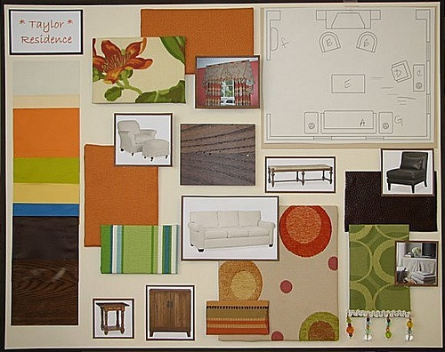

Slide 5
Items used in a presentation or portfolio are:
Elevations
Perspectives
Renderings
Overlays
Models

Slide 6
Elevations
An elevation is a drawing that shows width and height.

Slide 7
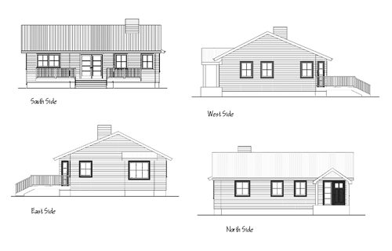
Exterior elevation
A set of scale drawings, usually 4, showing all sides of a house.

Slide 8
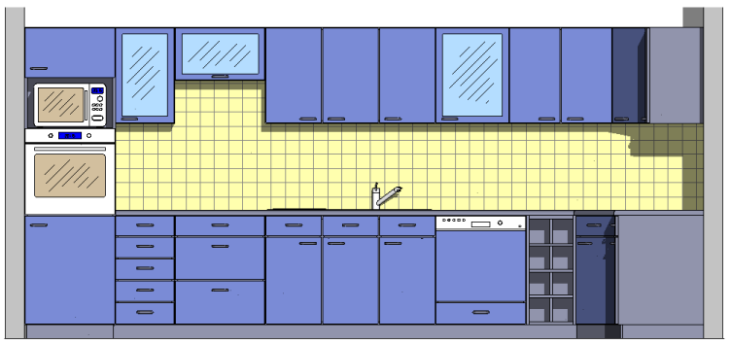
Interior elevation
A scale drawing that shows the view of one interior wall of a house.

Slide 9
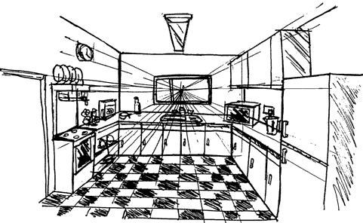
One Point Perspective
Shows what is seen when the viewer looks directly at the opposite wall.

Slide 10
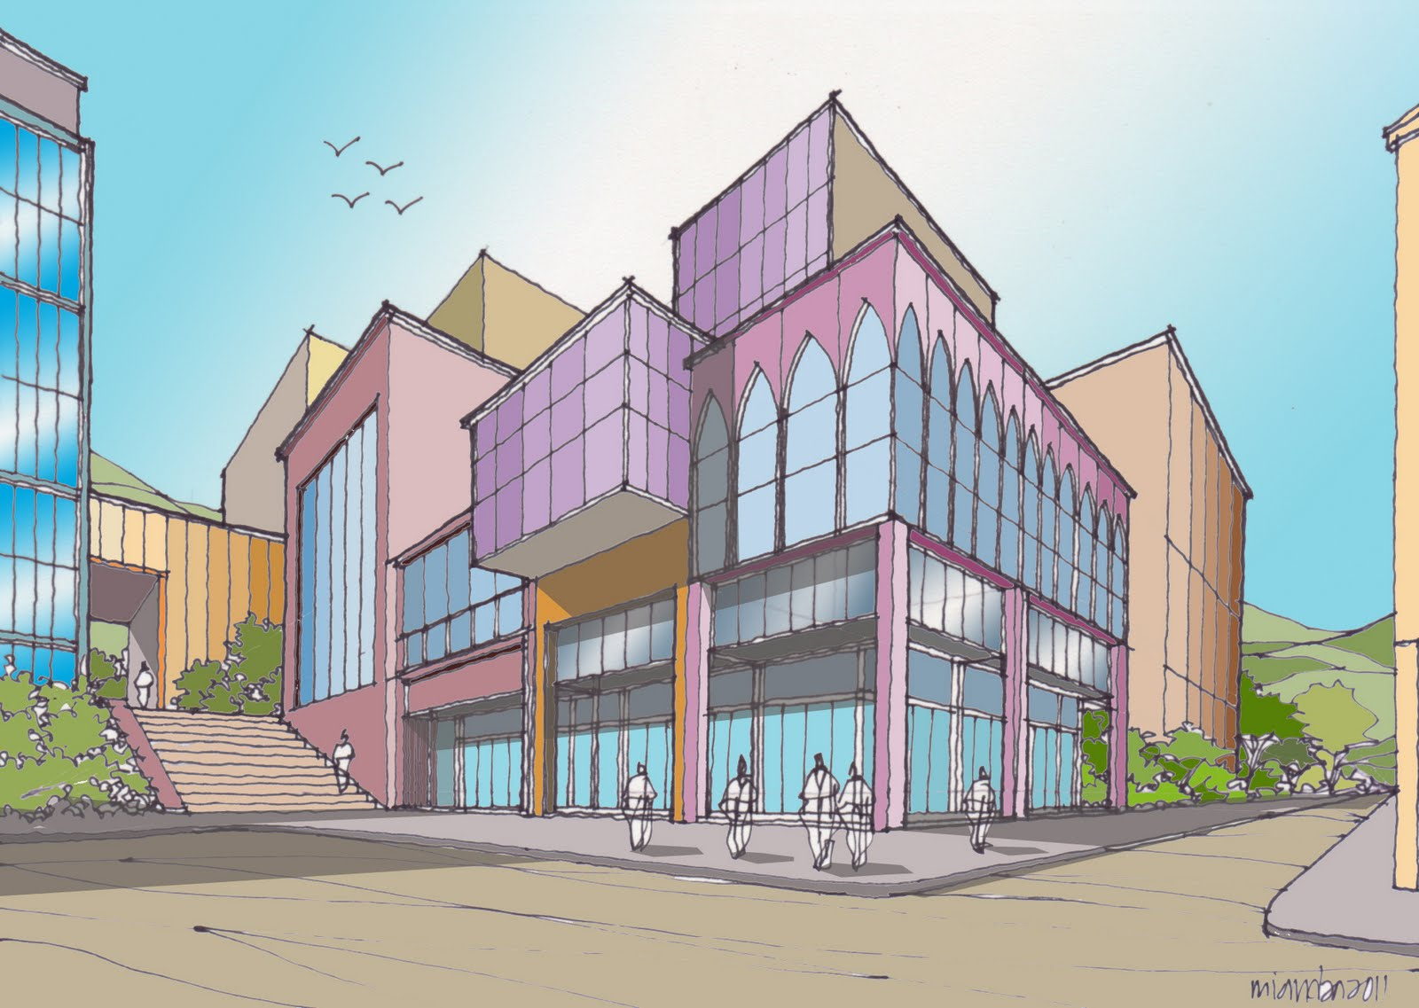
Two Point Perspective
Shows two exterior walls on a building where a corner appears close and the sides extend from these corners.

Slide 11
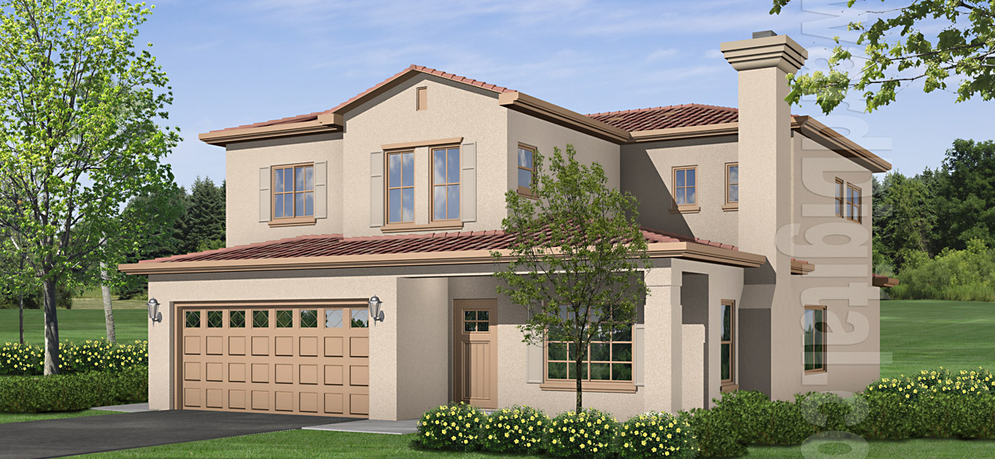
Renderings
A drawing, usually with color, to show a realistic view of a building or room
Different types of renderings are…….

Slide 12
Pencil Renderings
Quickest rendering to produce
Usually done with a soft-lead pencil
Can smear or smudge over time.

Slide 13
Ink Renderings
Make good quality prints with uniform line widths
Take more time to complete than a pencil
Are more permanent and store well.

Slide 14
Felt-tip Renderings
Produce colorful, dramatic renderings
May be combined with ink to add details.

Slide 15
Watercolor Rendering
Gives a realistic appearance to the presentation
Difficult technique that may require formal art training.

Slide 16
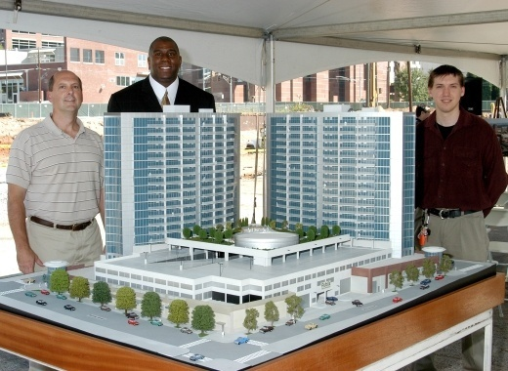
Model
A three-dimensional miniature of a design that provides a view from different angles and various lighting conditions.

Slide 17
Drawing Elevations

Slide 18
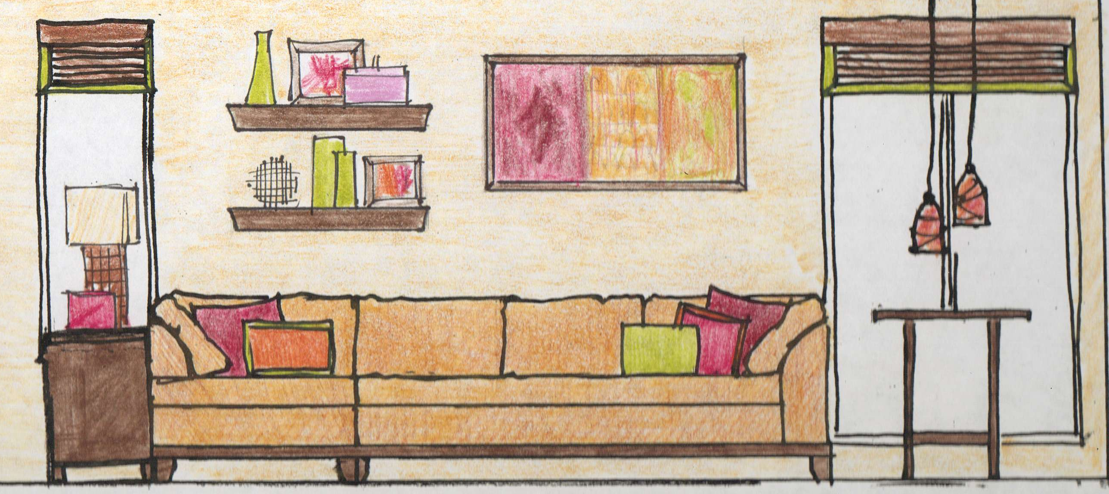

Slide 19
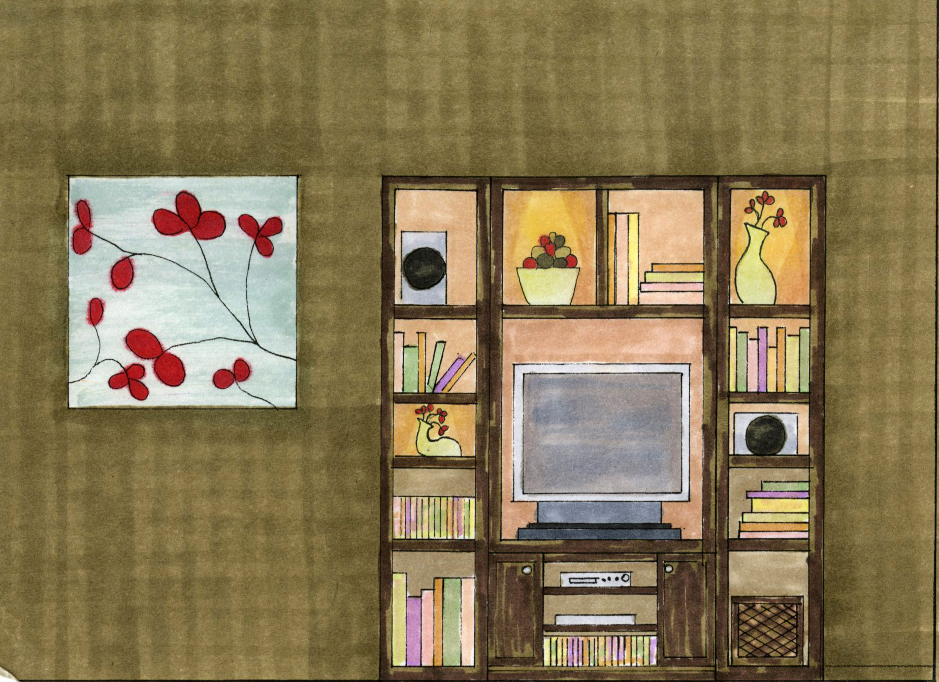

Slide 20
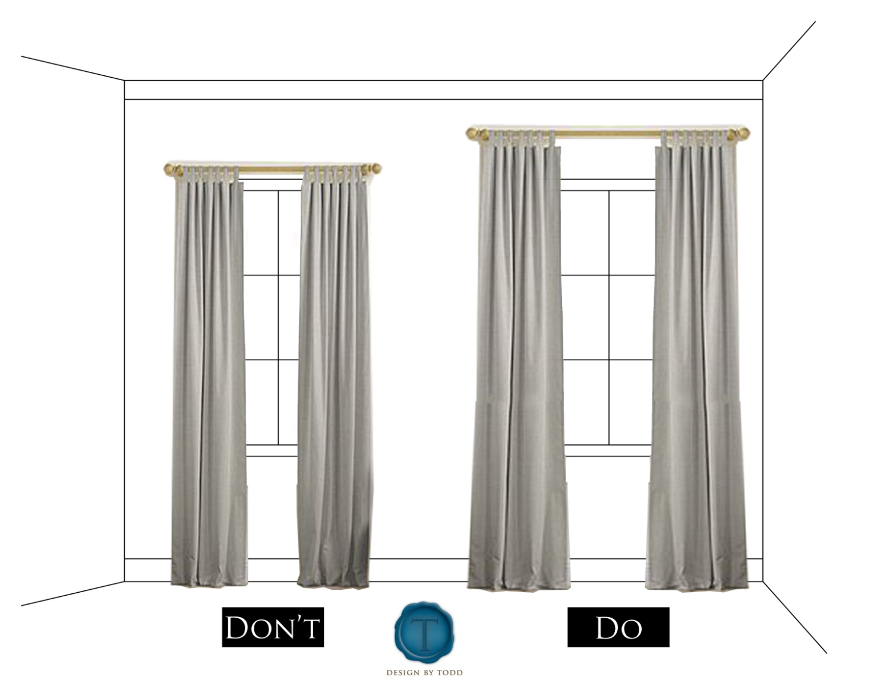

Slide 21
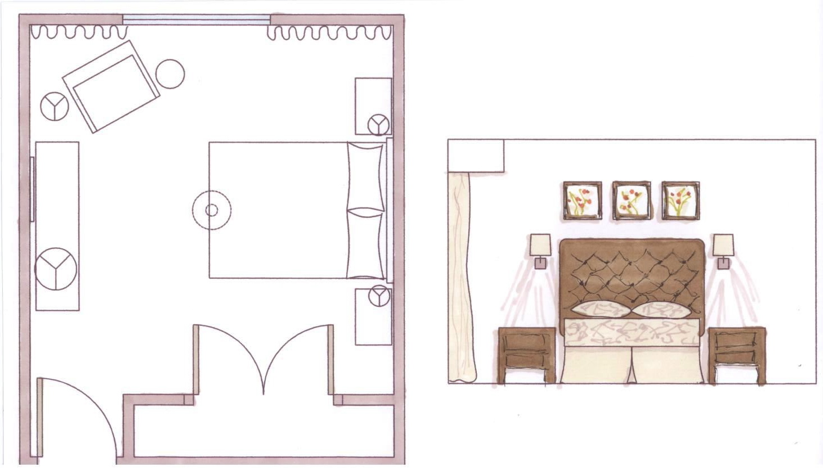

Slide 22
Notes:
Have students sketch a quick elevation.

