Slide 1
Creating a Business Card

Slide 2
Business Cards
Sometimes thought of as tiny billboards
The most often used marketing tool – small, inexpensive, easy to use
Only uses 3 ½ “ by 2” of space
Business cards are small in size but have a huge, lasting impact. Therefore, they must be designed carefully and thoughtfully

Slide 3
What kind of information is included on a business card?
Name of individual
Name of business or organization
Address
Phone number
E-mail address
Web page address
Job title of individual
Tagline or description of business or organization
Logo
Image(s)—including purely decorative elements
List of services or products

Slide 4
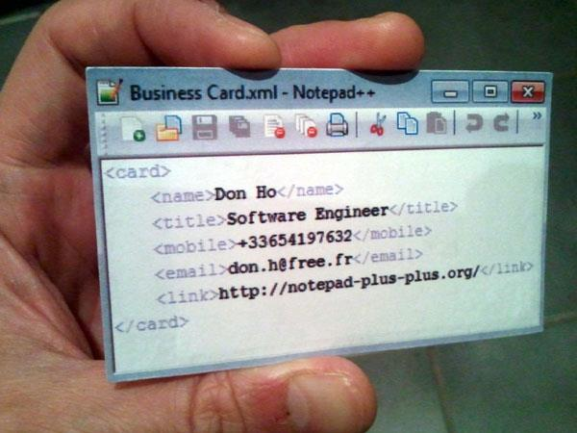
Choose the elements that make sense for the individual and the business. Choose qualities you want to emphasize.

Slide 5
How can you make your point in such a small space using only a few words?
Different fonts
Color
Metaphor
Logos (symbol)
Other images

Slide 6
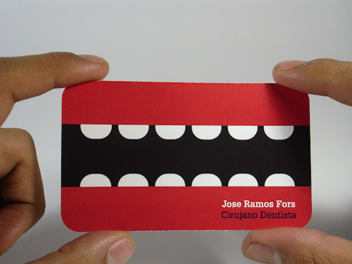

Slide 7
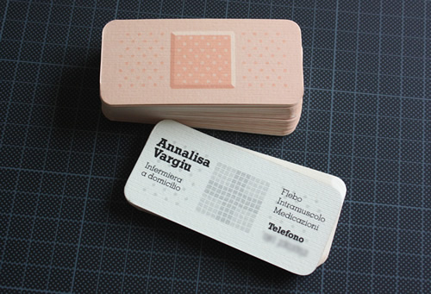

Slide 9
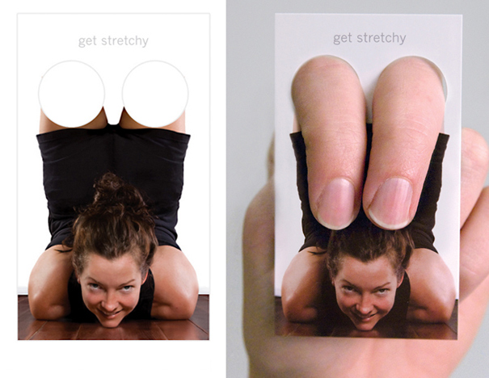

Slide 10
Creating your business card…let’s get started

Slide 11
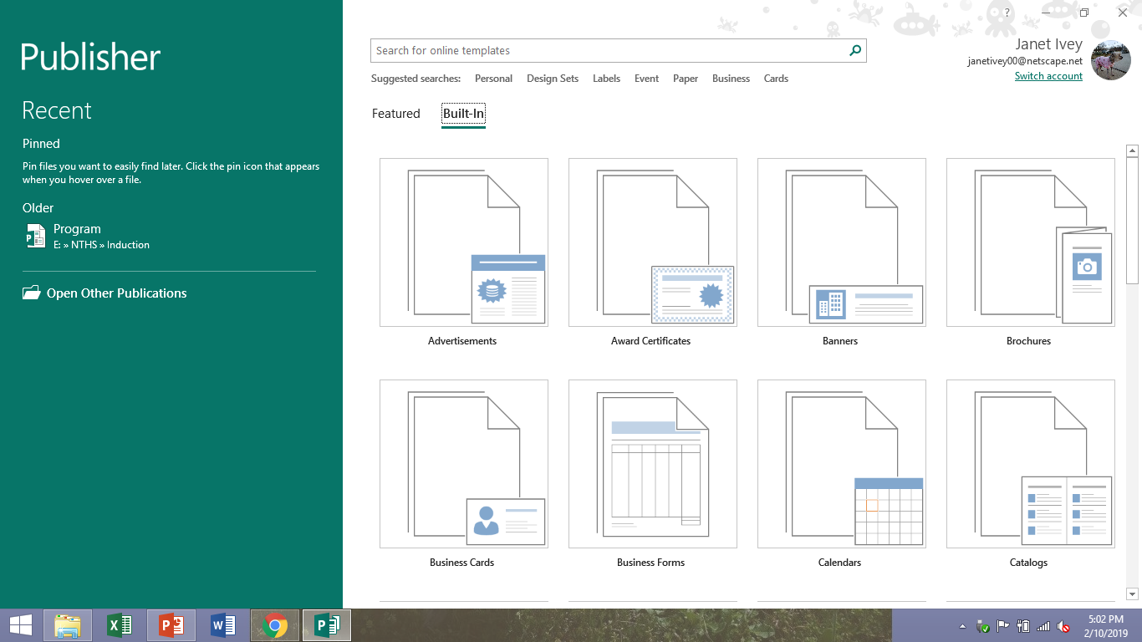
Open Publisher
1
2

Slide 12
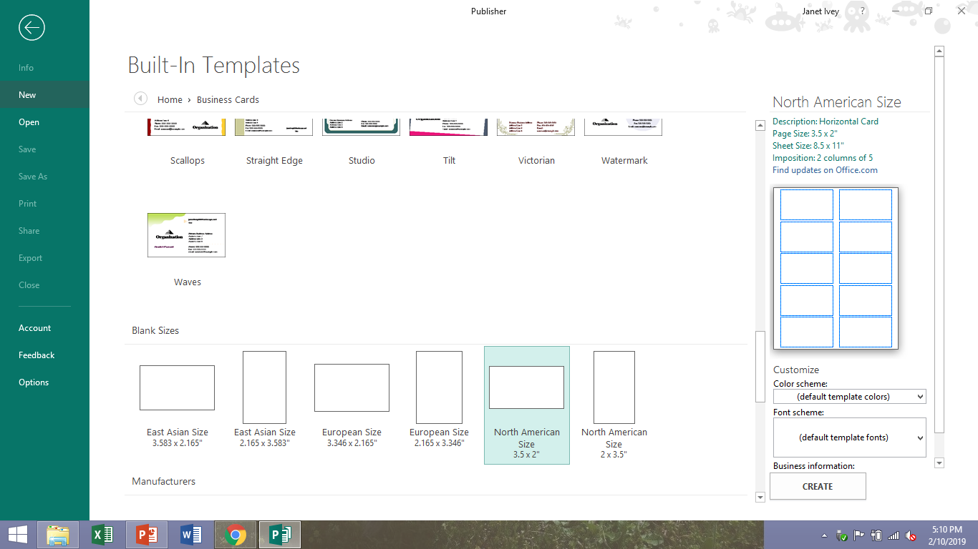
Scroll down page and click on 1 of the 2 templates. Then click on “create”.

Slide 13
Create a logo: https://www.freelogodesign.org
Create your logo
Save to the computer desktop
Once you have made your business card, you can click on “insert” then “picture” and choose the logo on the desktop.

Slide 14
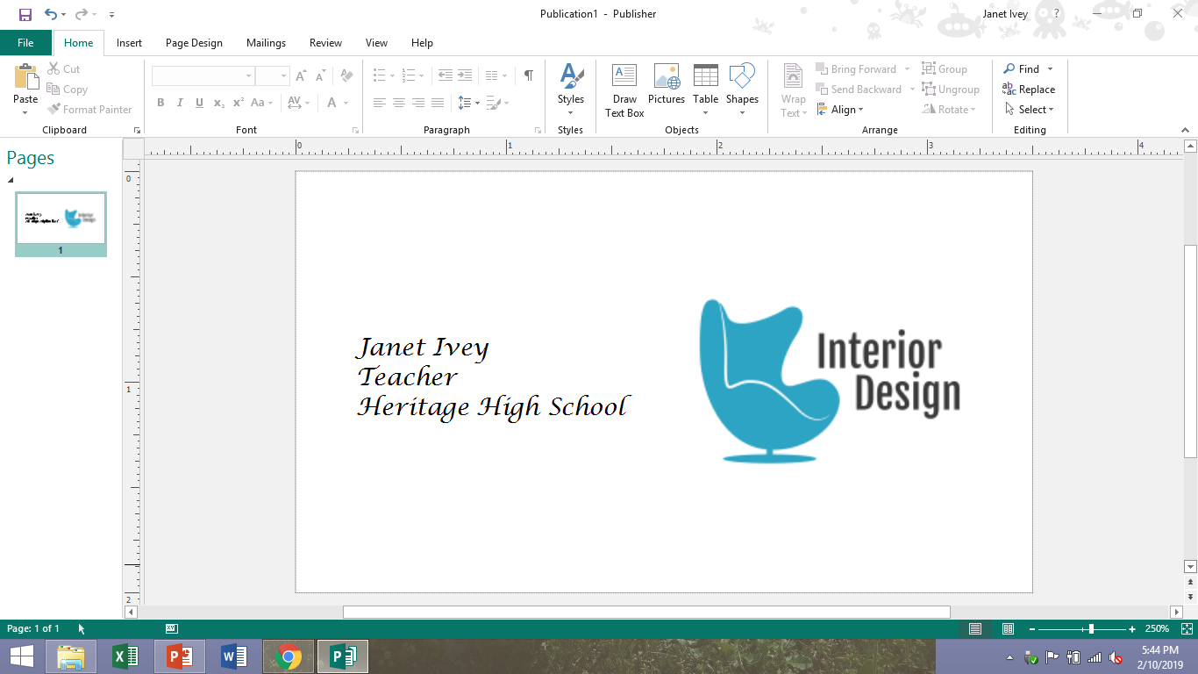
This represents 1 business card. Add text boxes and insert the information for 1 partner.

Slide 15
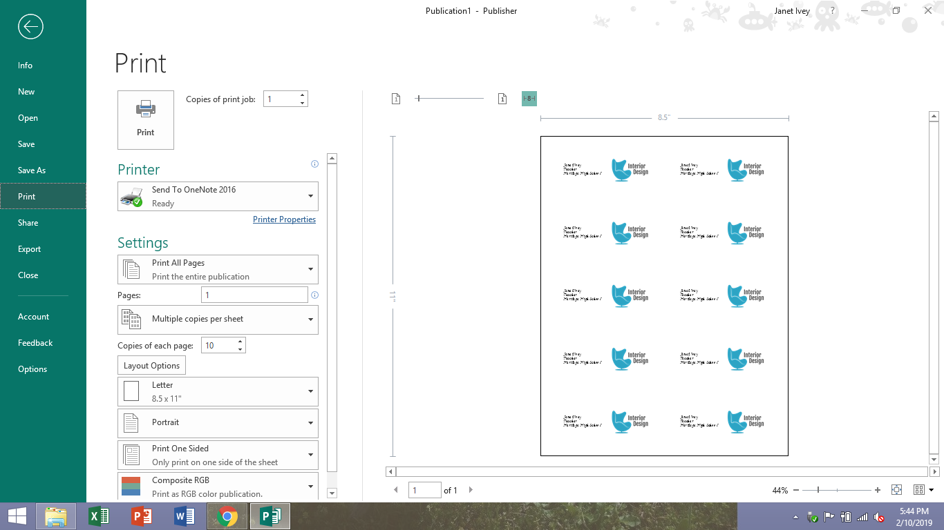
Print for the first partner. It will automatically create 10 business cards. Then change the name to the second partner and print again.

