Slide 1
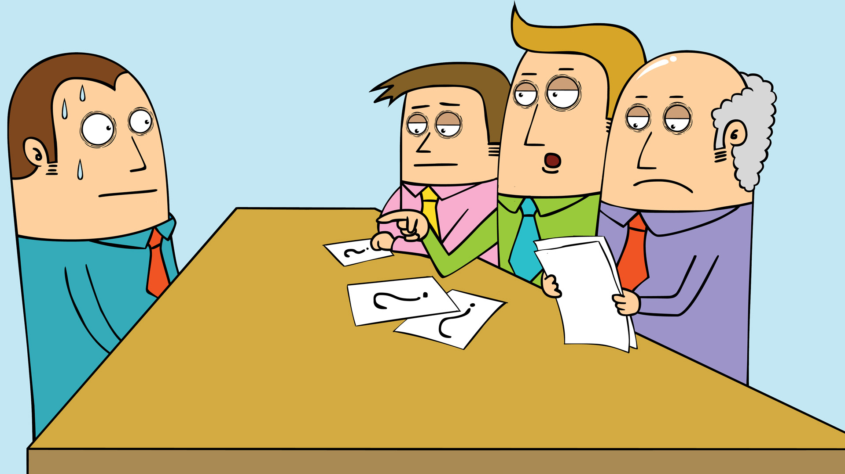
How to answer some common interview questions

Slide 2
Tell me about yourself.
Tell them how long you have lived in the area (if it has been several years or why you have recently moved here).
Quickly summarize your job skills or volunteer experiences.

Slide 3
What did you like best about school?
Tell them you especially liked working on team projects, any time you were in charge of a project, or organized any activity.
If you are/were in a CTE class share some of the skills and abilities you obtained through that opportunity.

Slide 4
Why are you leaving your current job?
I am looking to increase my responsibilities.
With this economy I needed more hours than they were able to supply.
Business is closing.
It is a career area I would like to explore.
I have been at my present job for quite a while and would like more experience.

Slide 5
Why do you want to work for us?
I have enjoyed my past experience with this company as a customer, client etc.
I have been told it is a great place to work.
I believe my skills and abilities are a good match.
It would fit with my long-range career goals.
I have always wanted to work here.

Slide 6
Have you ever been asked to leave a position?
If… No (answer is complete)
If….Yes
My position changed and my available hours no longer matched those of the position
If other reasons- try and keep it positive

Slide 7
Why should we hire you?
I am reliable and will work hard. If you hire me, you will get someone who is not afraid to learn and is willing to go the extra mile.

Slide 8
Tell me about your weaknesses.
Probably my greatest weakness is my inexperience, but I am a quick learner, I want to work and you can teach me how you would like the job done.

Slide 9
What are your strengths?
If you have any strengths that fit the job, share those, if not…
Tell them you want to work, to learn and do the best possible job you can.

Slide 10
Tell me about a problem you had (or a mistake you made) and how you solved it.
Think of a situation at school, on a team, on the job and how you handled it. Talk about communication, getting help from someone else, etc.

