Slide 1
OBJECTIVE 1.03: Demonstrate job seeking skills

Slide 2
In order to apply for a job you will need:
Letterhead
Resume
References
Cover letter
Information for an application
Interview skills.

Slide 3
Visually Appealing Letterhead
Letterhead is
personalized stationery that contains your name and all contact information
the largest and most prominent feature on a résumé. It needs to stand out
Employers may take an extra glance if your résumé is attractive
Don’t get too carried away. Keep it clean and professional.

Slide 4
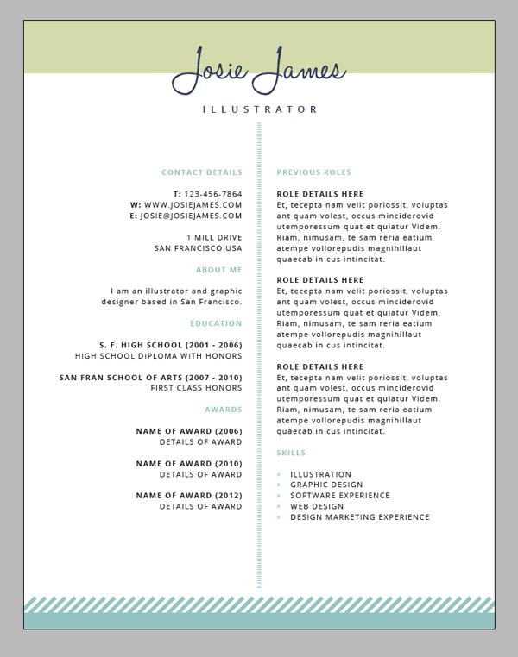

Slide 5
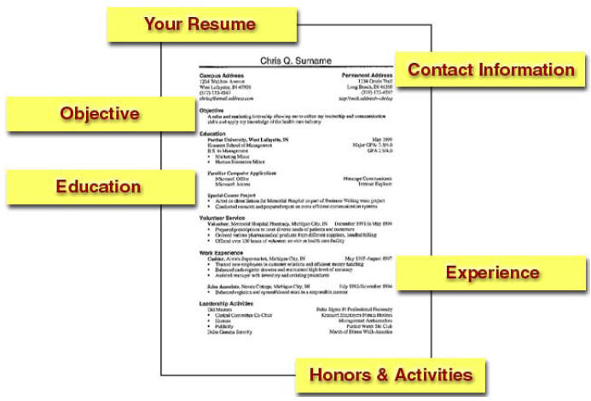
Resumes
1 page
Information in reverse chronological order
Use phrases or incomplete sentences that start with an ACTION verb
NO abbreviations.

Slide 6
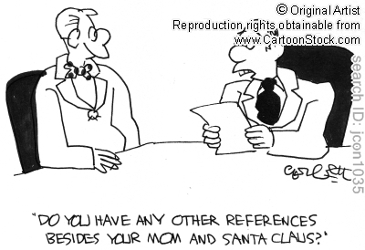
References
Include: Name, Title, Company where they work, Work Address, City, State, Zip, Work Phone, Email
Always ask before listing someone as a reference
Usually a separate page. Needs to MATCH your résumé
You will need 3 – NO RELATIVES.

Slide 7
Sample References

Slide 8
If you want to use me…
REFERENCES
Janet Ivey
Interior Design Teacher
Heritage High School
1150 Forestville Road
Wake Forest, North Carolina 27587
919-570-5600
jivey@wcpss.net

Slide 9
Create a resume and reference sheet

Slide 10
Cover Letter
Serves as in introduction to you and your resume
Typed on separate page that MATCHES your resume and references
A cover letter says, “Here’s what I can do for you” A resume says, “Here’s how I can do it”
Find out the name of the specific individual who will receive your letter
Personalize the letter to the specific position
Concentrate on skills which match the advertised employment qualifications or the desired program of study
Sound upbeat and confident. Sell yourself!

Slide 11
What do employers look for in a cover letter?

Slide 12
Find a job and create a cover letter.

Slide 13
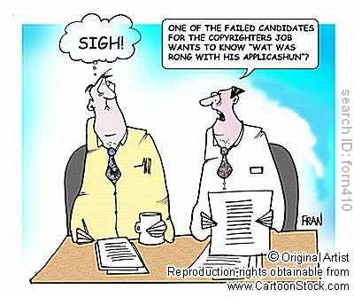
Applications
Read completely BEFORE writing
Use blue or black ink
Answer all questions accurately and honestly
Use NA or Not Applicable or draw a line through a space – do not leave blanks
If asked for salary requirements put “Negotiable”
Do not mark through mistakes
Use a dictionary.

Slide 14
Complete an application

Slide 15
The Origins of Job Interviews

Slide 16
Typical Interview Questions

Slide 17
Typical Interview Questions
Tell me a about yourself.
Give me an example of a time when you exercised leadership.
How do you handle yourself in stressful situation?
What is the biggest mistake you ever made?
What did you learn from this mistake?
Tell me why I should hire you for this job.
What is your greatest accomplishment?
Describe your ideal job.
What motivates you?

Slide 18
Why are you leaving your job?
Why do you want to work for us?
Why should we hire you?
Tell me about your weaknesses.
Tell me about your strengths.
What are 3 words that describe you.
What did you like best in school?
Do you have any questions for me?

Slide 19
Sample Legal and Illegal questions

Slide 20
Religion
Legal
Can you work weekends?
Do you belong to any professional or trade groups?
Illegal
What church do you belong?

Slide 21
National Origin
Legal
Are you authorized to work in the United States?
What languages do you speak, read, or write fluently?
Illegal
Are you a United States citizen?

Slide 22
Age
Legal
Are you over the age of 18?
Illegal
How old are you?

Slide 23
Disability
Legal
Can you perform the specific duties of the job?
Illegal
Do you have any disabilities?
Tell me about your medical history.

Slide 24
Marital or Family Status
Legal
Can you work overtime?
Is there any reason you cannot start at 7:30 am?
Illegal
Are you married?
How many children do you have?
Are you pregnant?

Slide 25
Personal
Legal
Are you able to lift a 50 lb weight and carry it 100 yards as part of the job?
Illegal
How tall are you?
How much do you weigh?

Slide 26
Criminal Record
Legal
Have you ever been convicted of a crime?
Illegal
Have you ever been arrested?
Have you ever spent the night in jail?

Slide 27
Military
Legal
What type of training or education did you receive in the military?
Illegal
Were you honorably discharged?
In what branch of the military did you serve?

Slide 28
Questions to ask the interviewer
Describe your ideal employee.
How does an employee succeed on your team?
What are some of the objectives you would like to see accomplished in this job?

Slide 29
Interview Do’s
Go alone
Arrive 10 minutes early
Dress appropriately for the job you are applying for
Give a firm handshake when meeting the interviewer and wait until you are told to be seated.
Maintain good posture and eye contact. Show enthusiasm; smile.
Pay attention to your body language.
Emphasize positive things about yourself.
Be honest with your answers.
Preplan several questions that you can ask about the position or company
Ask when to expect a decision
Thank the interviewer for his/her time.

Slide 30
Interview Do Not’s
Take anyone with you to the interview
Arrive late
Wear excessive make-up, jewelry or perfume
Ask about the salary
Hesitate before answering a question
“Bad Mouth” a former employer or past co-workers
Talk a lot about your personal life or appear as a “know it all”
Lack confidence.

Slide 31
Assignment
Practice interviewing using the documents you have created.

Slide 32
Follow-Up with a thank you letter that restates your interest in the position.

